Slide 1
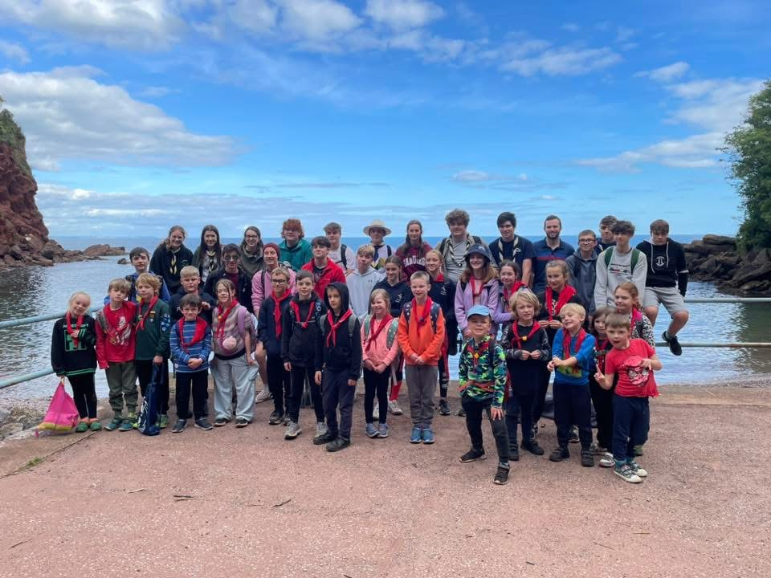
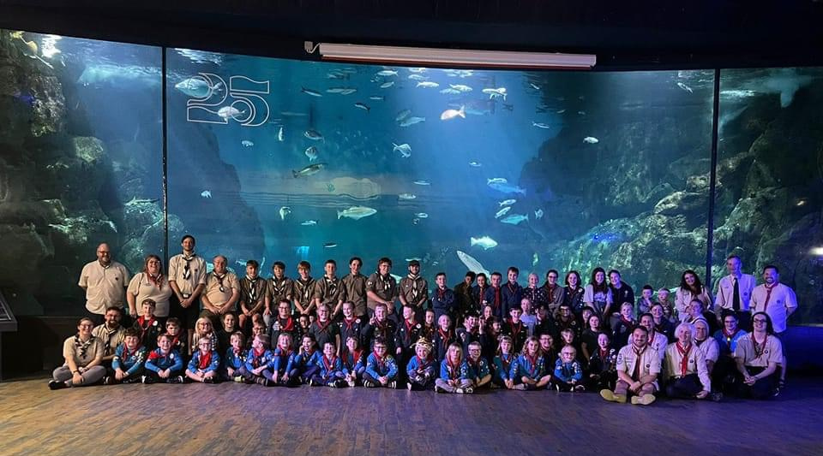
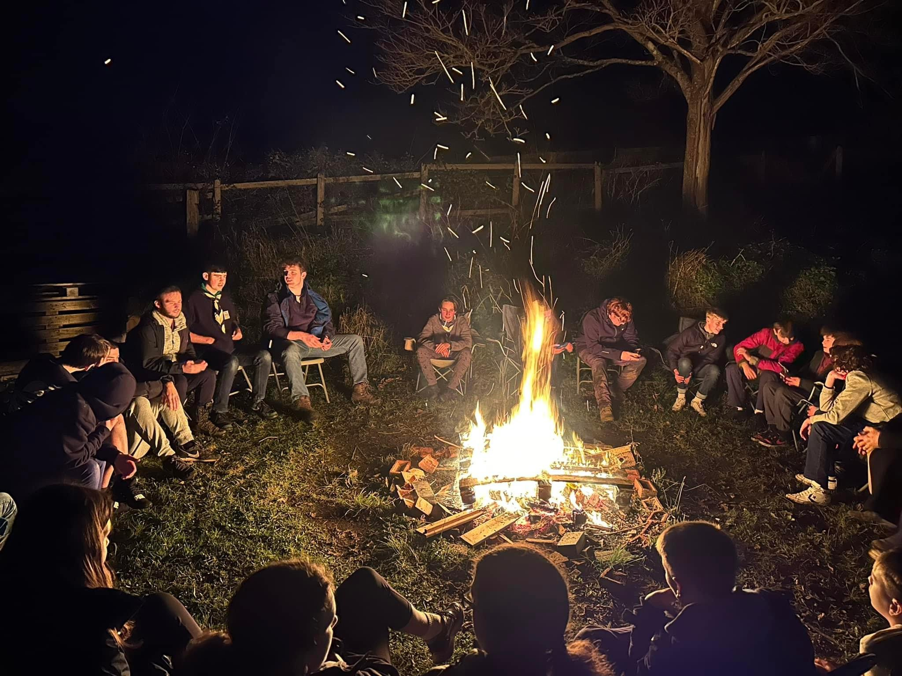
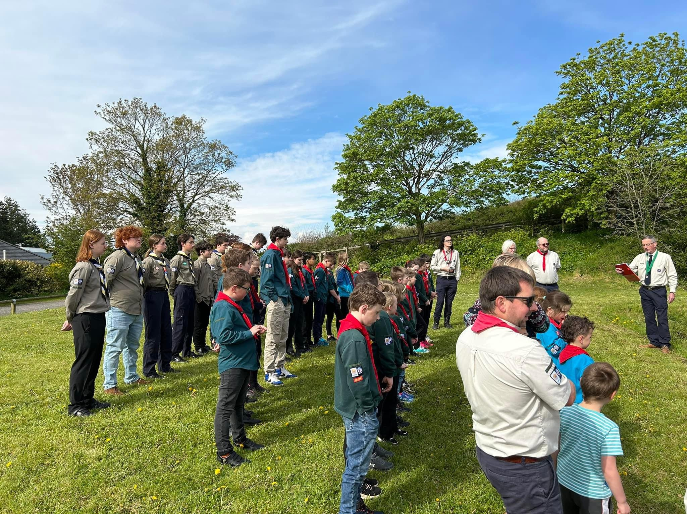
Welcome Pack
1st Highweek Village
Welcome to the worldwide family of Scouts!
This welcome pack aims to answer any questions that you may have about the Scout Association and 1st Highweek Village Scout Group. If you have any further queries or concerns, please do not hesitate to contact me or your section Leader.
Andrew Thorpe, Group Lead Volunteer
Email: andrew.p.thorpe@outlook.com
1st Highweek Village Scout Group
There has been Scouting in Highweek for over 100 years
Highweek Scout Hut opened in 1974
The Group previously used the Village Hall
We run the following sections:
Beavers, aged 6 – 8
Cubs, aged 8 – 10
Scouts, aged 10 – 14
Explorers, aged 14 – 18
We are supported by:
15 Uniformed Leaders
A Trustee Board
Young Leaders
Parent Helpers
What is Scouting?
Scouting is an international movement with over 28 million members worldwide, spread through 216 countries and territories. The number of countries recognising the value of Scouting and accepting its principles are increasing and there are only six countries in the world which do not offer Scouting to young people.
In total, there are about 500,000 people in Membership throughout the United Kingdom. This includes approximately about 100,000 adults who have taken up appointments as voluntary leaders, administrators and supporters.
The Scout Association in the UK accepts members of all major faiths and offers equal opportunities to all young people, no matter what their social, religious or ethnic background may be.
In 1991, girls were admitted to the Beaver Scout, Cub Scout and Scout Sections. This complemented the admission of young women to the Venture Scout Section in 1976.
During the spring of 2002, the Scout Association launched a new programme for young people aged 6-25. This was the largest change to our curriculum for nearly 40 years. A careful strategy of change management was devised to help people move forward, delivering a totally new way of providing Scouting to the 14-25 age range.
In September 2021 the newest and youngest section of Scouting was launched for 4 to 6 year-olds, Squirrels, to help young people gain skills for life at a time when it matters most and where it's most needed.
scouts.org.uk/join
#SkillsForLife
Copyright 2018 The Scout Association Registered Charity numbers 306101/SC038437
/scoutsassociation
@UKScouting

Slide 2
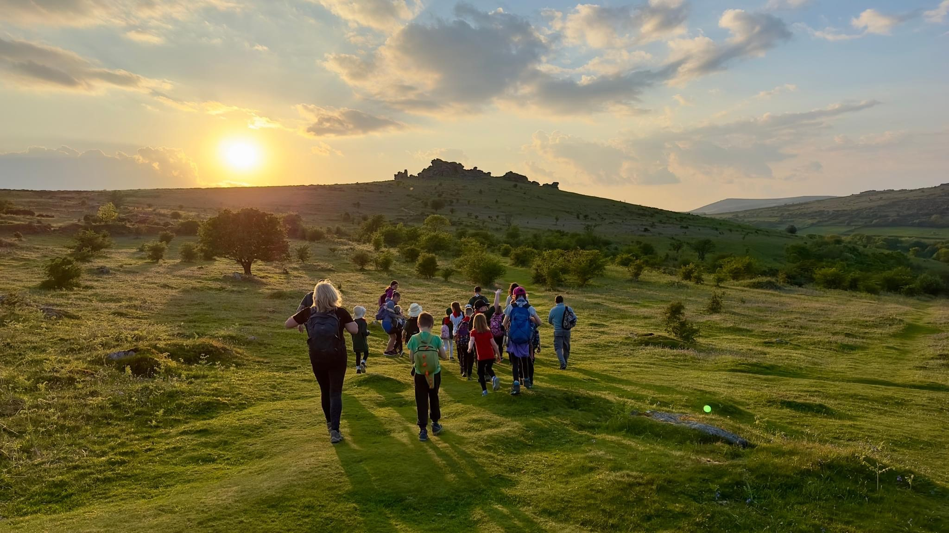
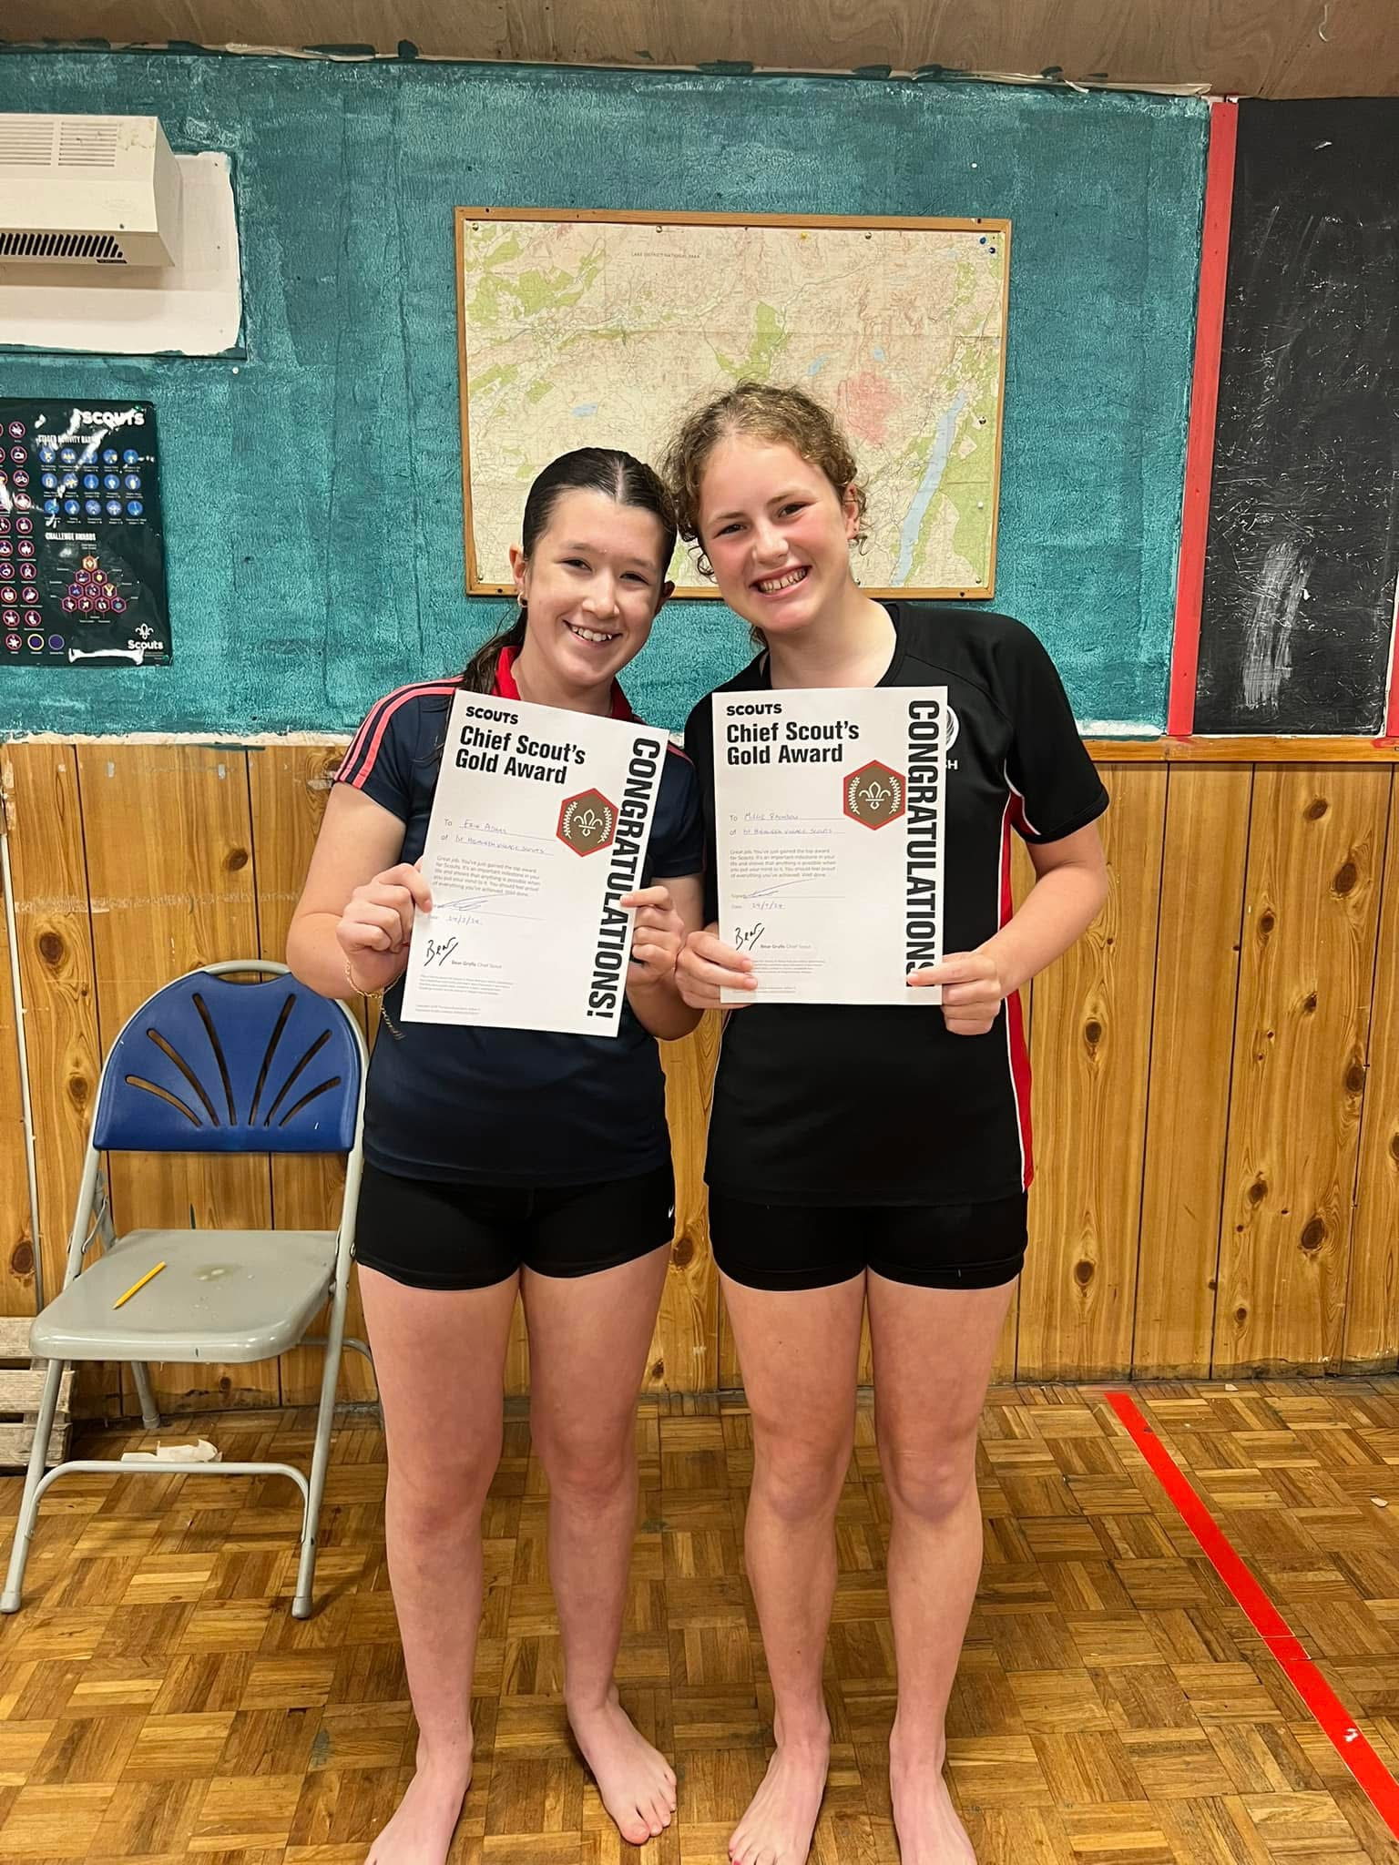
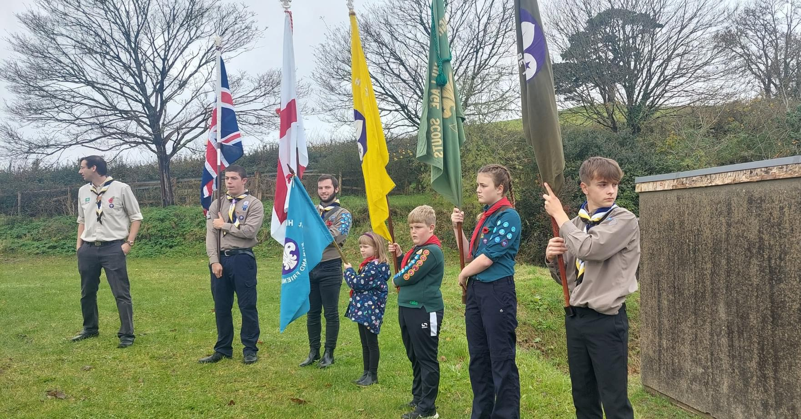
The Scout Promise:
Scouting has a simple and positive promise that is required to be made by all members.
The Promise together with the Scout Law, gives a distinctive ethos to the practices of the Movement and acts as a bond with Scouts in other countries.
The three key principles are:
Duty to self
Duty to god
Duty to others
Everyone in Scouting expresses their membership and acceptance of the three key principles by taking the Promise and following the Scout Law. Beaver Scouts and Cub Scouts have their own Promise and Law, suitable for their age range. There are alternative promises available for all religions and those with no religion.
The Scout Promise:
On my honour, I promise that I will do my best
Either
To do my duty to God and to the King,
Or
To uphold our Scout values, to do my duty to the King,
To help other people
And to keep the Scout Law
The Scout Law:
A Scout is to be trusted.
A Scout is loyal.
A Scout is friendly and considerate. A Scout belongs to the worldwide family of Scouts.
A Scout has courage in all difficulties.
A Scout makes good use of time and is careful of possessions and property.
A Scout has self-respect and respect for others.
The Scout Motto:
Be Prepared!
The Purpose of Scouting
Scouting in the UK is organised through The Scout Association.
The Scout Association has a clear purpose:
‘To help young people achieve their full physical, intellectual, social and spiritual potential as individuals, as responsible citizens and as Members of their local, national and international communities’.
Even if we can’t solve all the problems in the world, we can help to make it a better place. We do this by helping young people to develop as active members of their community:
who are self-reliant
who are caring
who are responsible
who show commitment
Scouting works well when young people enjoy learning by doing in partnership with adults. They do this by taking part in a variety of activities and new experiences exploring the outdoors participating in teams taking responsibility.
Our method for giving young people the opportunity to learn by doing is called the Programme. The Programme is a seamless progression of training, activities and awards that covers everything that young people can do in Scouting from the ages of 4 to 25.
All adults in Scouting have a responsibility to make sure that the Programme is fun and exciting.
We must also make sure that it is safe.
The Scout Association’s policies, rules, code of behaviour, advice on child protection and safety are there to help adults make sure that the young people in their care stay safe while they enjoy themselves and learn.

Slide 3
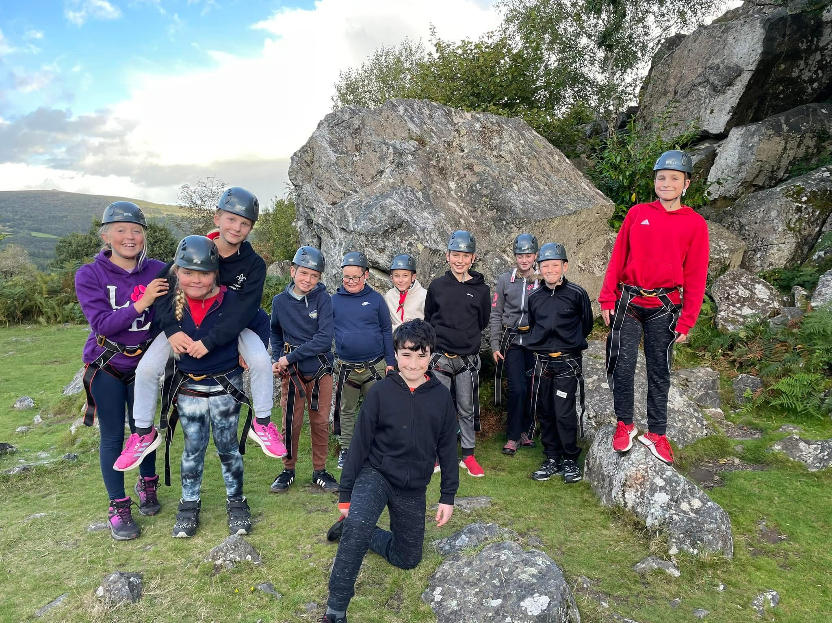
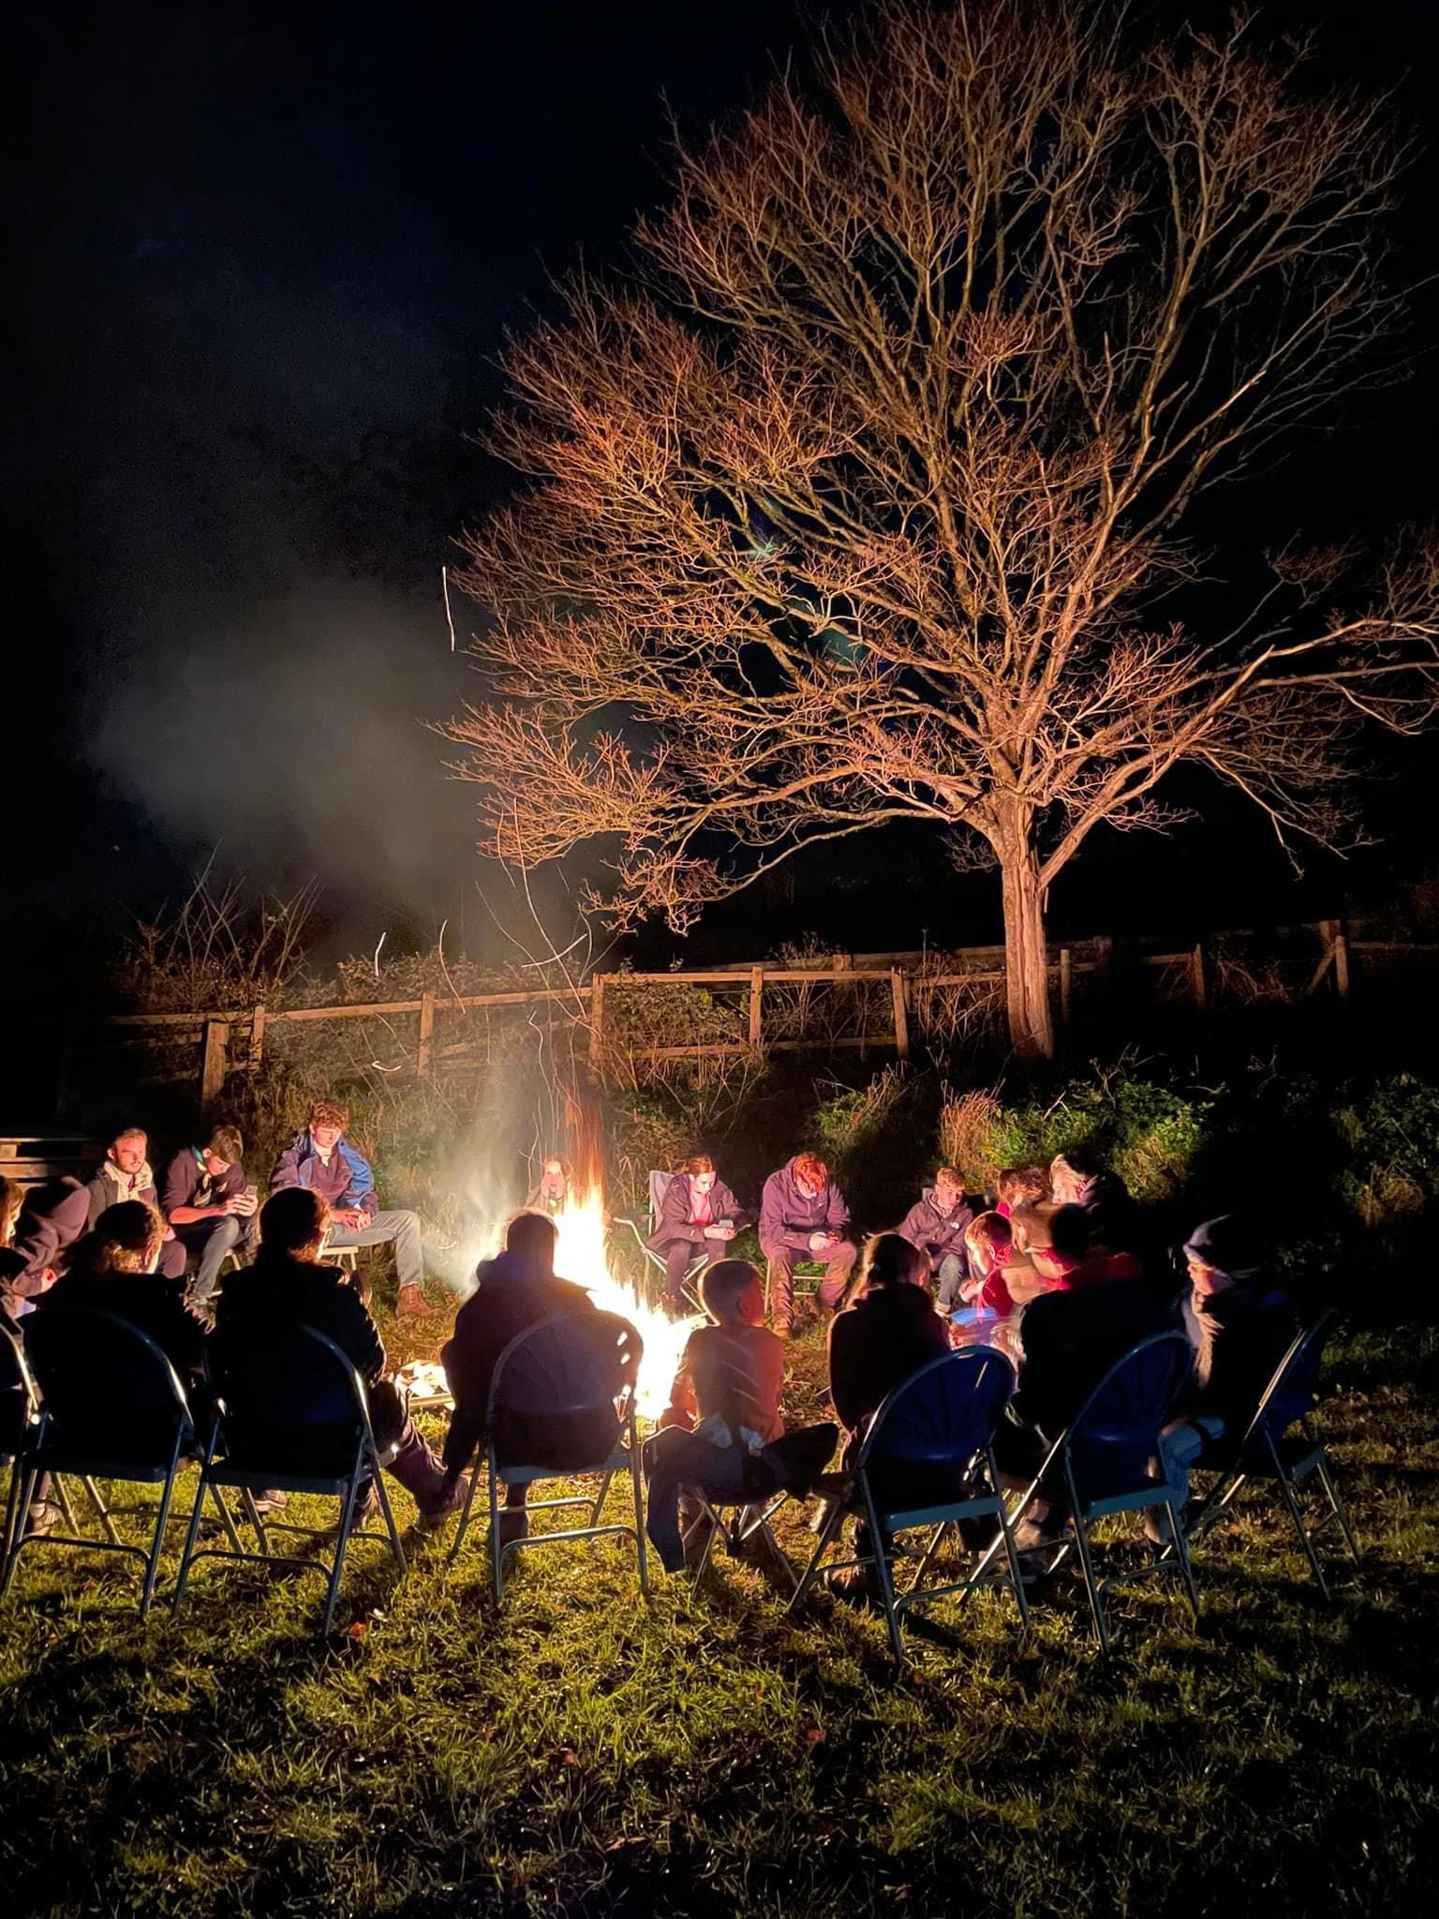
The Sections
Irrespective of a member’s age, a young person in the Movement is a ‘Scout’.
The balanced Programme spans the 4-25 age range which is made up of six Sections.
Each Section has its own identity, ethos and style. They all have adult support that varies in style across the different age groups.
A Squirrel Drey has members aged 4 to 6 years of age. (currently not operating at 1st Highweek Village)
A Beaver Scout Colony has members aged between 6 and 8. (minimum age 5 ¾, maximum age 8 ½ applies)
A Cub Scout Pack has members aged 8 – 10 ½ (6-month flexibility applies)
A Scout Troop is for young people aged from 10 ½ - 14 years (6-month flexibility applies)
These 4 Sections are all part of a Scout Group.
An Explorer Scout Unit is for young people from 14-18 years old (minimum age 13 ½, maximum age 18). Explorer Scout Units are part of a Scout District (Teignbridge District), although some are attached to Groups, (1st Highweek Village has an attached Explorer Unit).
A Scout Network is for young people aged 18 - 25 years old. Scout Networks are the responsibility of the Scout County (Devon).
What makes Scouts stand out?
There are several important things, which make Scouting different from many other youth organisations:
We are a uniformed movement
We use ‘Lodges, Sixes’ and ‘Patrols’ of about 6 young people who work together, learning from and supporting each other
We involve young people in decision making as part of their development
We offer volunteering and training to adults who wish to join us in a variety of roles.
Our Scout Hut
Most Section meetings take place at Highweek Scout Hut, Howton Road, Highweek. TQ12 1QH
The What3Word Location for our hut is: ///shapeless.clincher.loitering
We are fortunate to own our own hut and the land it sits on, and we currently have planning permission granted to extend and modernise the facilities. This will help safeguard the Group for future Scouts to enjoy and also provide a warm and welcoming venue for the residents of Highweek to use.

Slide 4

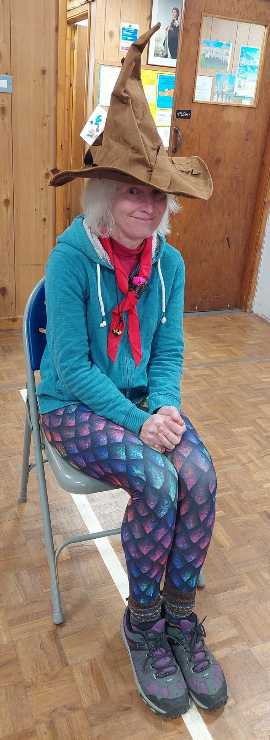
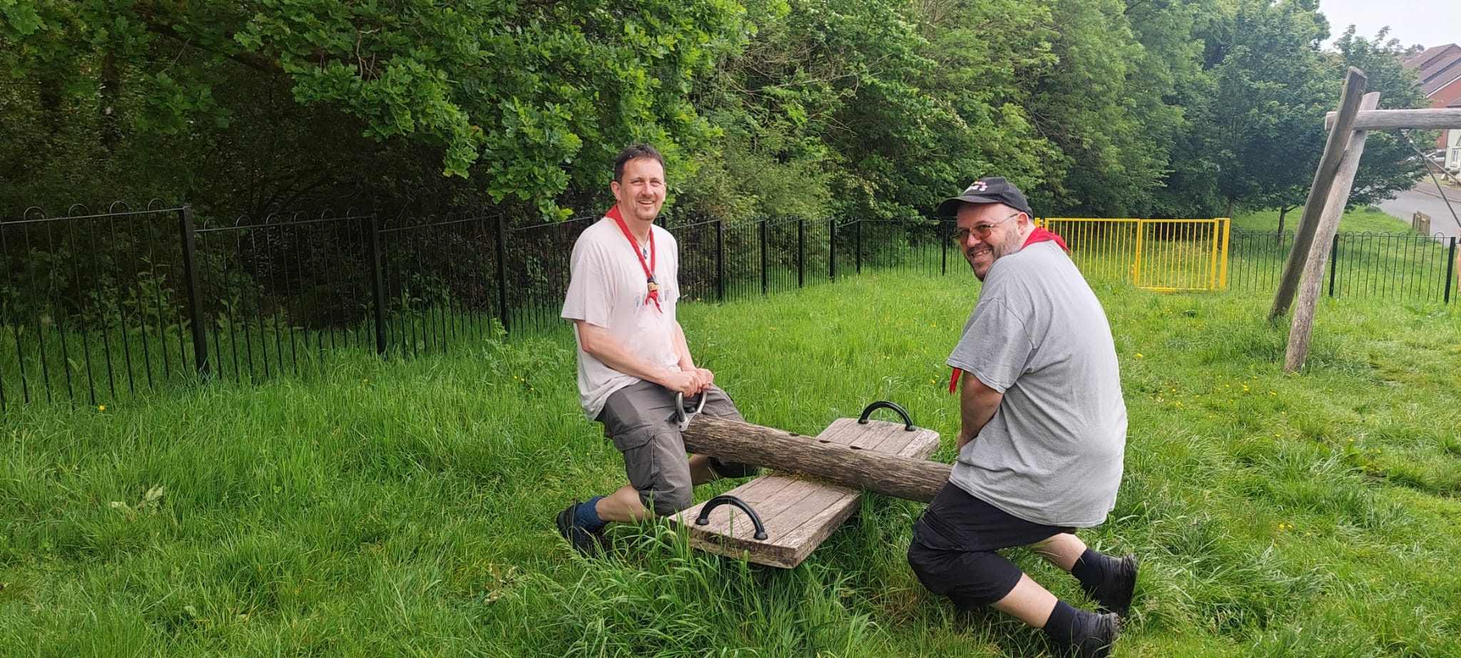
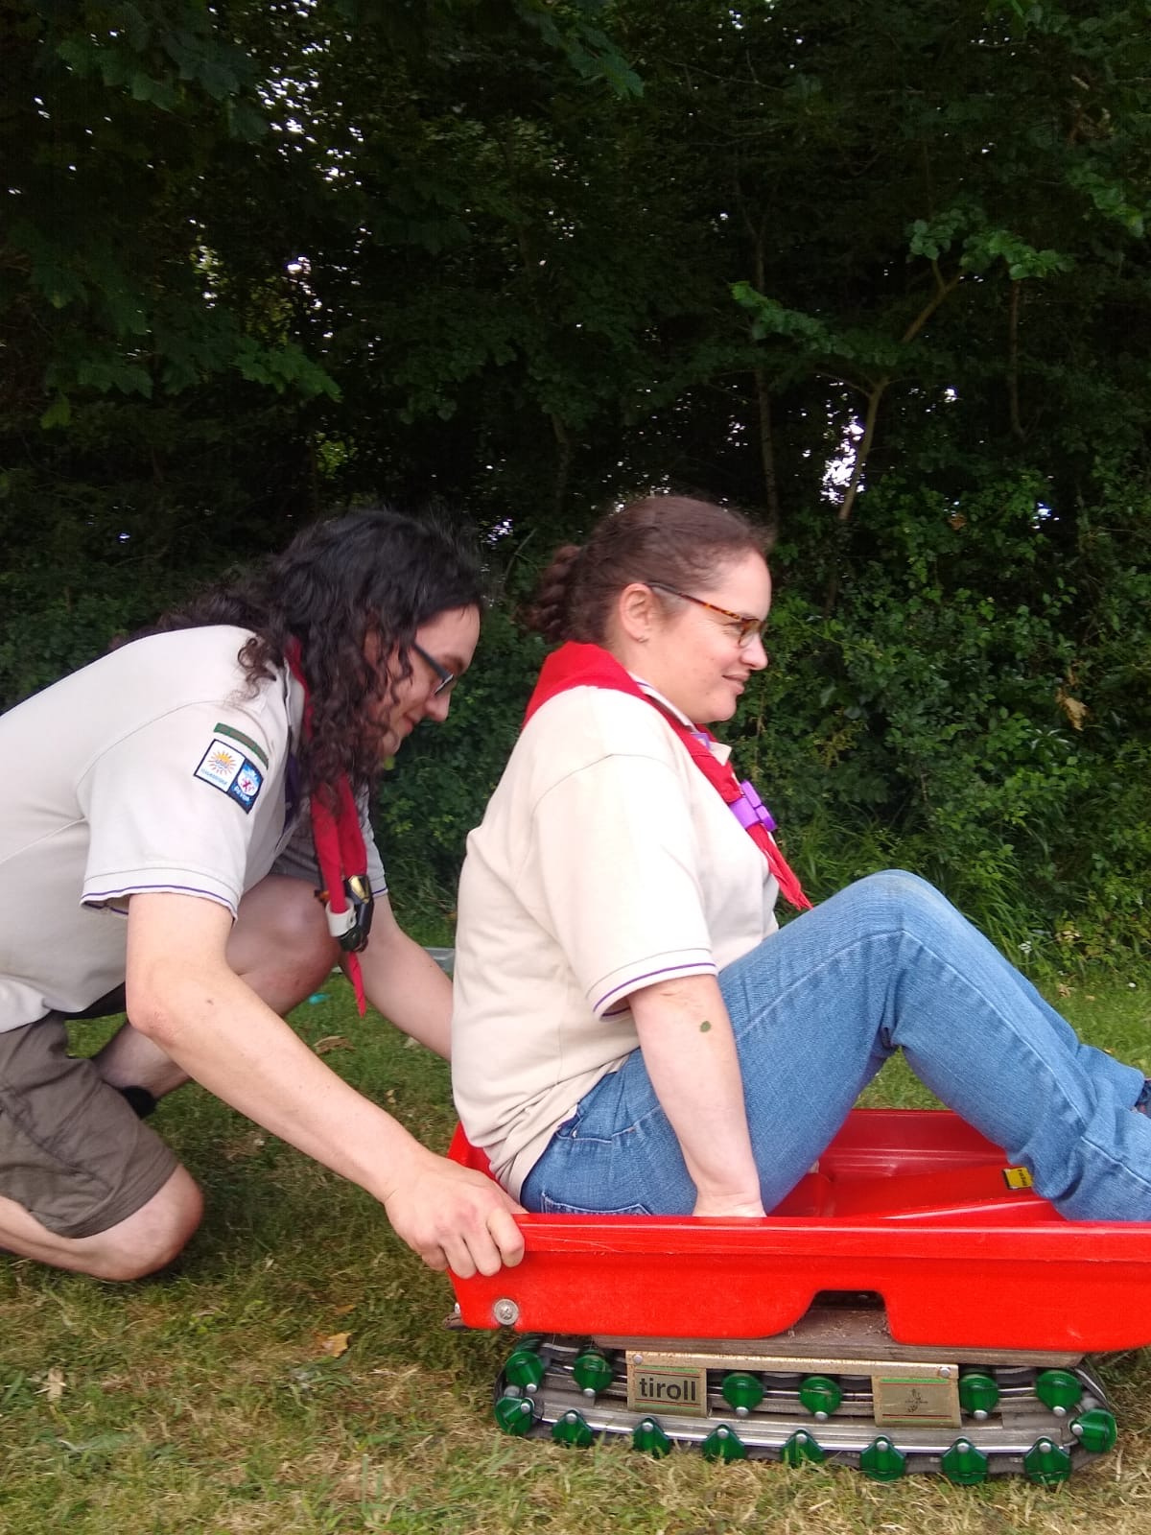
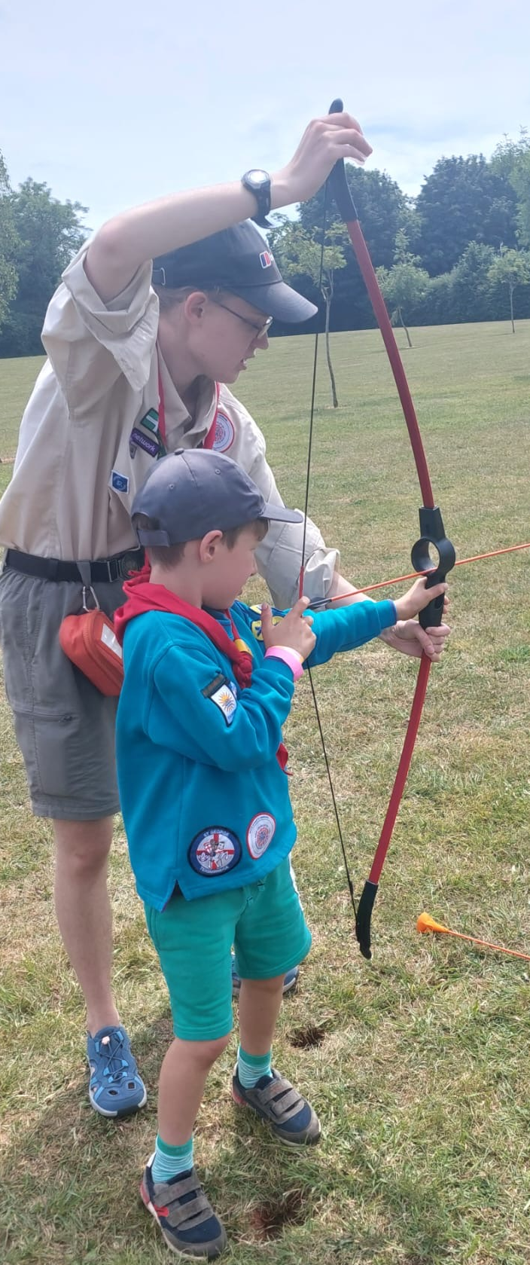
Your Beaver Leaders:
The core age range is from 6 to 8 years. A young person may join at 5¾ years and remain until 8½. They meet together as a Colony and work within small groups called ‘Lodges’.
A team of adults will run the Beaver Scout Colony. Beavers take part in a wide range of activities. These include making things, singing, playing games, going on visits, investigating nature, listening to stories etc.
They do this through taking part in a programme of activities provided by the leadership team.
Beaver Scouts:
Learn about themselves – exploring their feelings and developing good habits of health and personal safety
Get to know people – finding out about people in their family, the family of Scouting, the local community and the wider world
Explore - discovering the exciting world of science, nature and technology, exploring the natural and man-made world
Care - growing and responding to the needs of others, the local community and the wider world
Beaver Scouts work towards challenge awards, which are awarded by taking part in the regular programme.
With hard work and regular attendance, Beavers can gain their Chief Scout Bronze Award, the highest award in Beavers.
Beavers also have the opportunity to gain Activity Badges, which they can word towards both inside and outside Colony meetings.
Highweek Beaver Scouts:
Meet every Tuesday, 18:00 to 19:15.
The Leaders at Highweek Beavers have each choosen names from the Jungle Book and are led by Mowgli who has been a Leader at Highweek for over 5 years.
Other Section Team Leaders at the Colony are Kim, Mysa & Bear, with a Young Leader called Hawkeye.
Beaver Contact Details:
Email: highweekbeavers@outlook.com

Slide 5

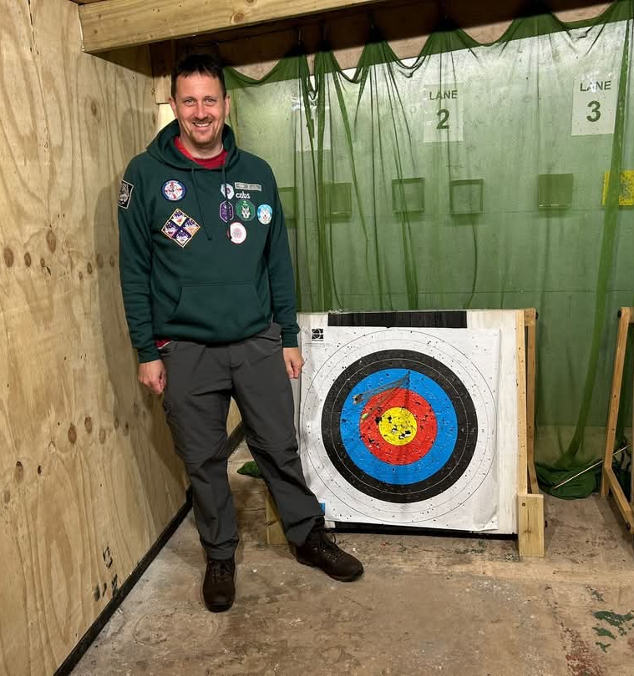
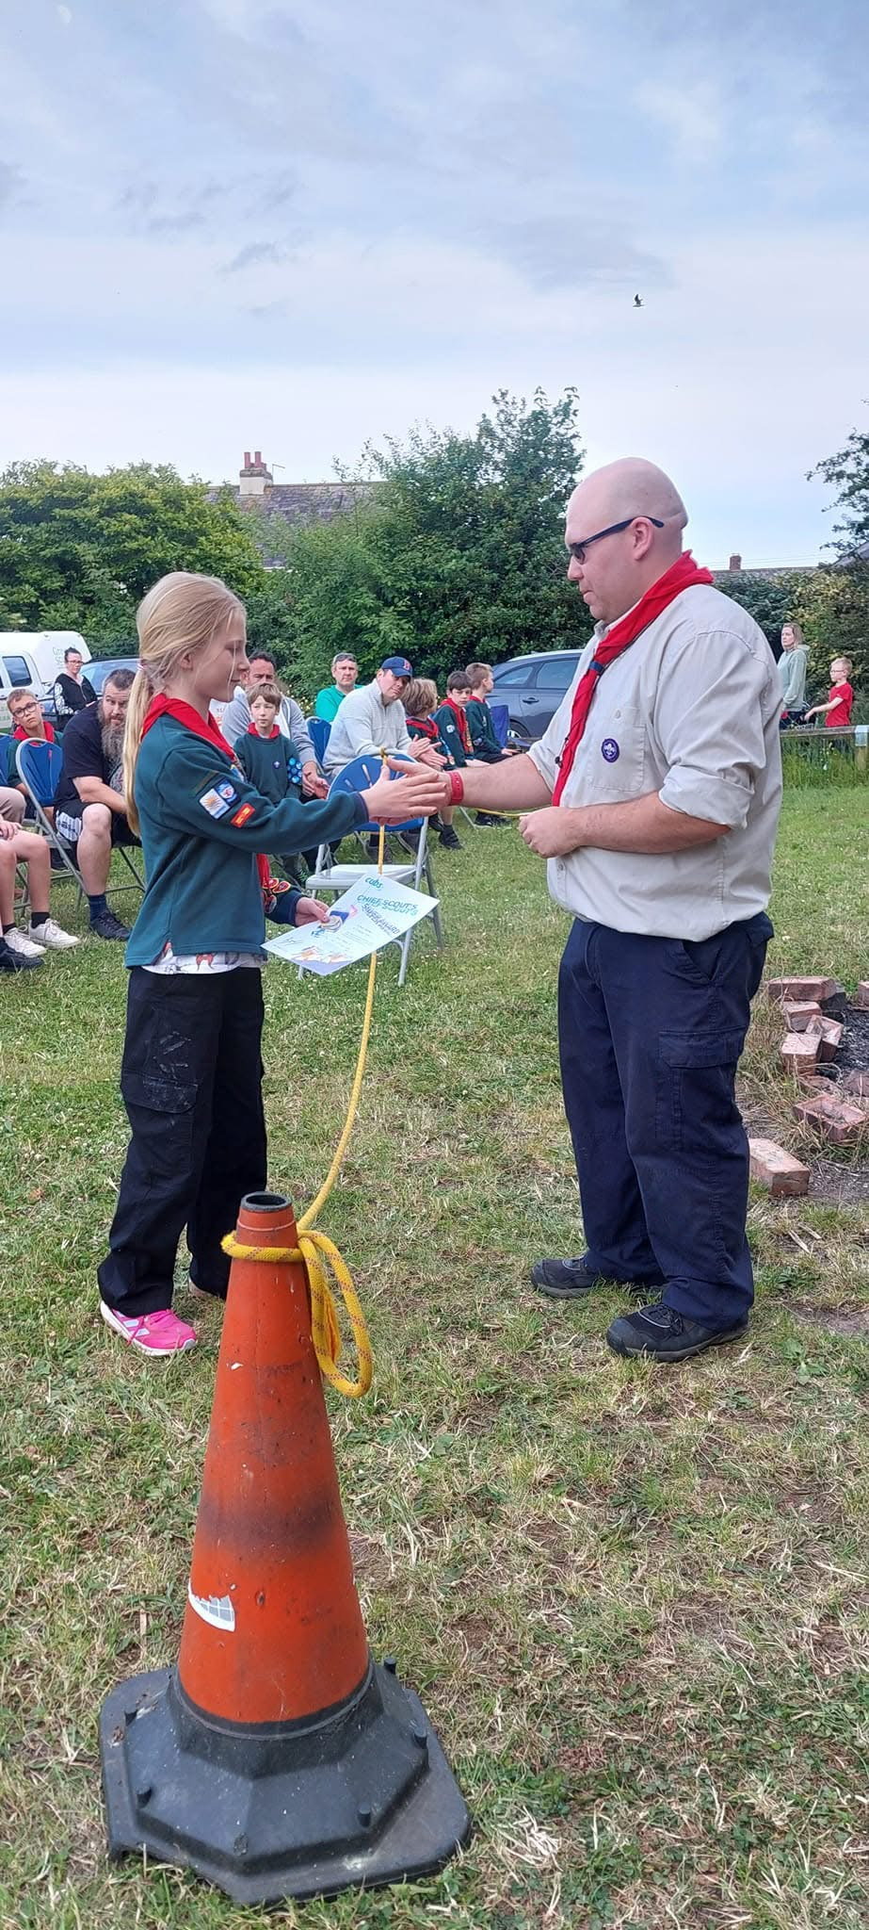
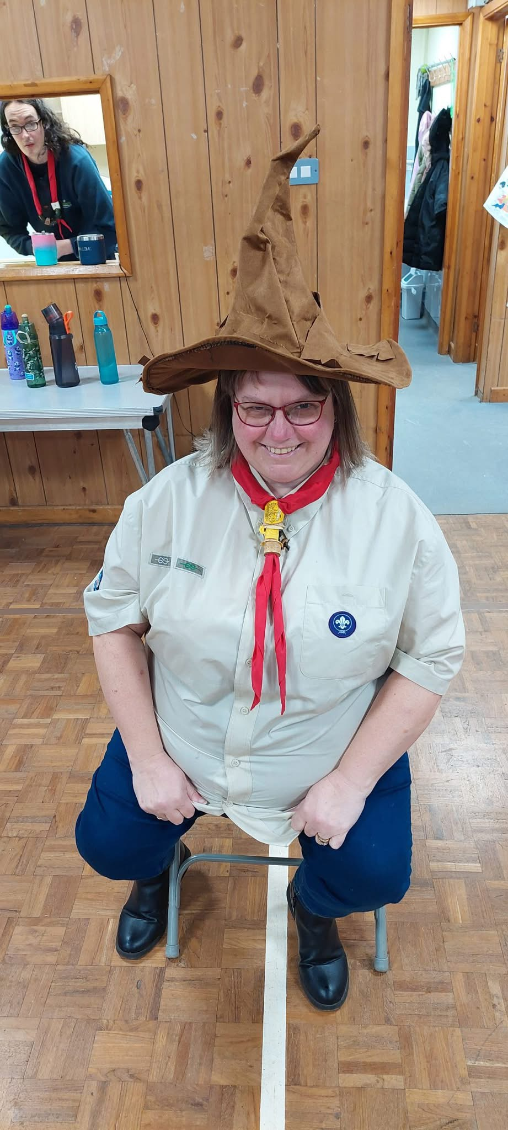
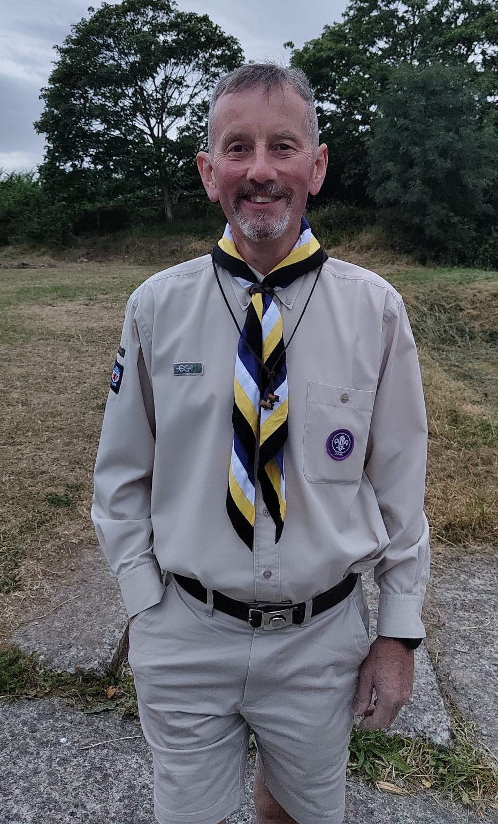
Your Cub Leaders:
The core age range is from 8 to 10½ years. A young person may join at 7½ years and remain in the Pack until their 11th birthday.
Cub Scouts meet together as a Pack and work within a variety of small groups called ‘Sixes’. A team of adults will run the Cub Scout Pack, usually led by an Akela, some will be uniformed leaders, others maybe Young Leaders or parent helpers.
Cubs take part in a wide range of activities that are designed to be interesting and challenging. At the same time they have fun, adventure and make friends along the way. They do this through taking part in a programme of activities provided by the Leadership team such as camping, playing games, trying new things and exploring the outdoors.
Cub Scouts work towards awards and badges:
The Cub Scout Membership Award is presented to new Cub Scouts once they have learnt about the traditions and history of Scouting and about being a Cub Scout today
Activity badges are specialist interest badges that can further develop a Cub Scout’s interest. They can also form the basis for special events and some are geared towards the whole pack working together
With hard work and regular attendance, Cub Scouts can gain their Chief Scout Silver Award, the highest award in Cubs.
Camps and outings are the most memorable events during the year. They offer the chance to try out activities that are not possible at the regular weekly meeting.
The Cub Scout Team Leader, usually Akela, has overall responsibility for the Pack and will lead the Leadership Team. It is however, very much a team effort with everyone having something to offer.
Highweek Cub Scouts:
Meet every Monday, 18:30 to 20:00.
The Leaders at Highweek Cubs have each chosen names from the Jungle Book and are led by Akela who has been a Leader at Highweek for over 17 years.
Other Section Team Leaders at Cubs are Bagheera & Rann. Kwasin & Shere Khan are Young Leaders with the Pack.
Cub Contact Details:
Akela’s Email: damion.dishart@gmail.com

Slide 6

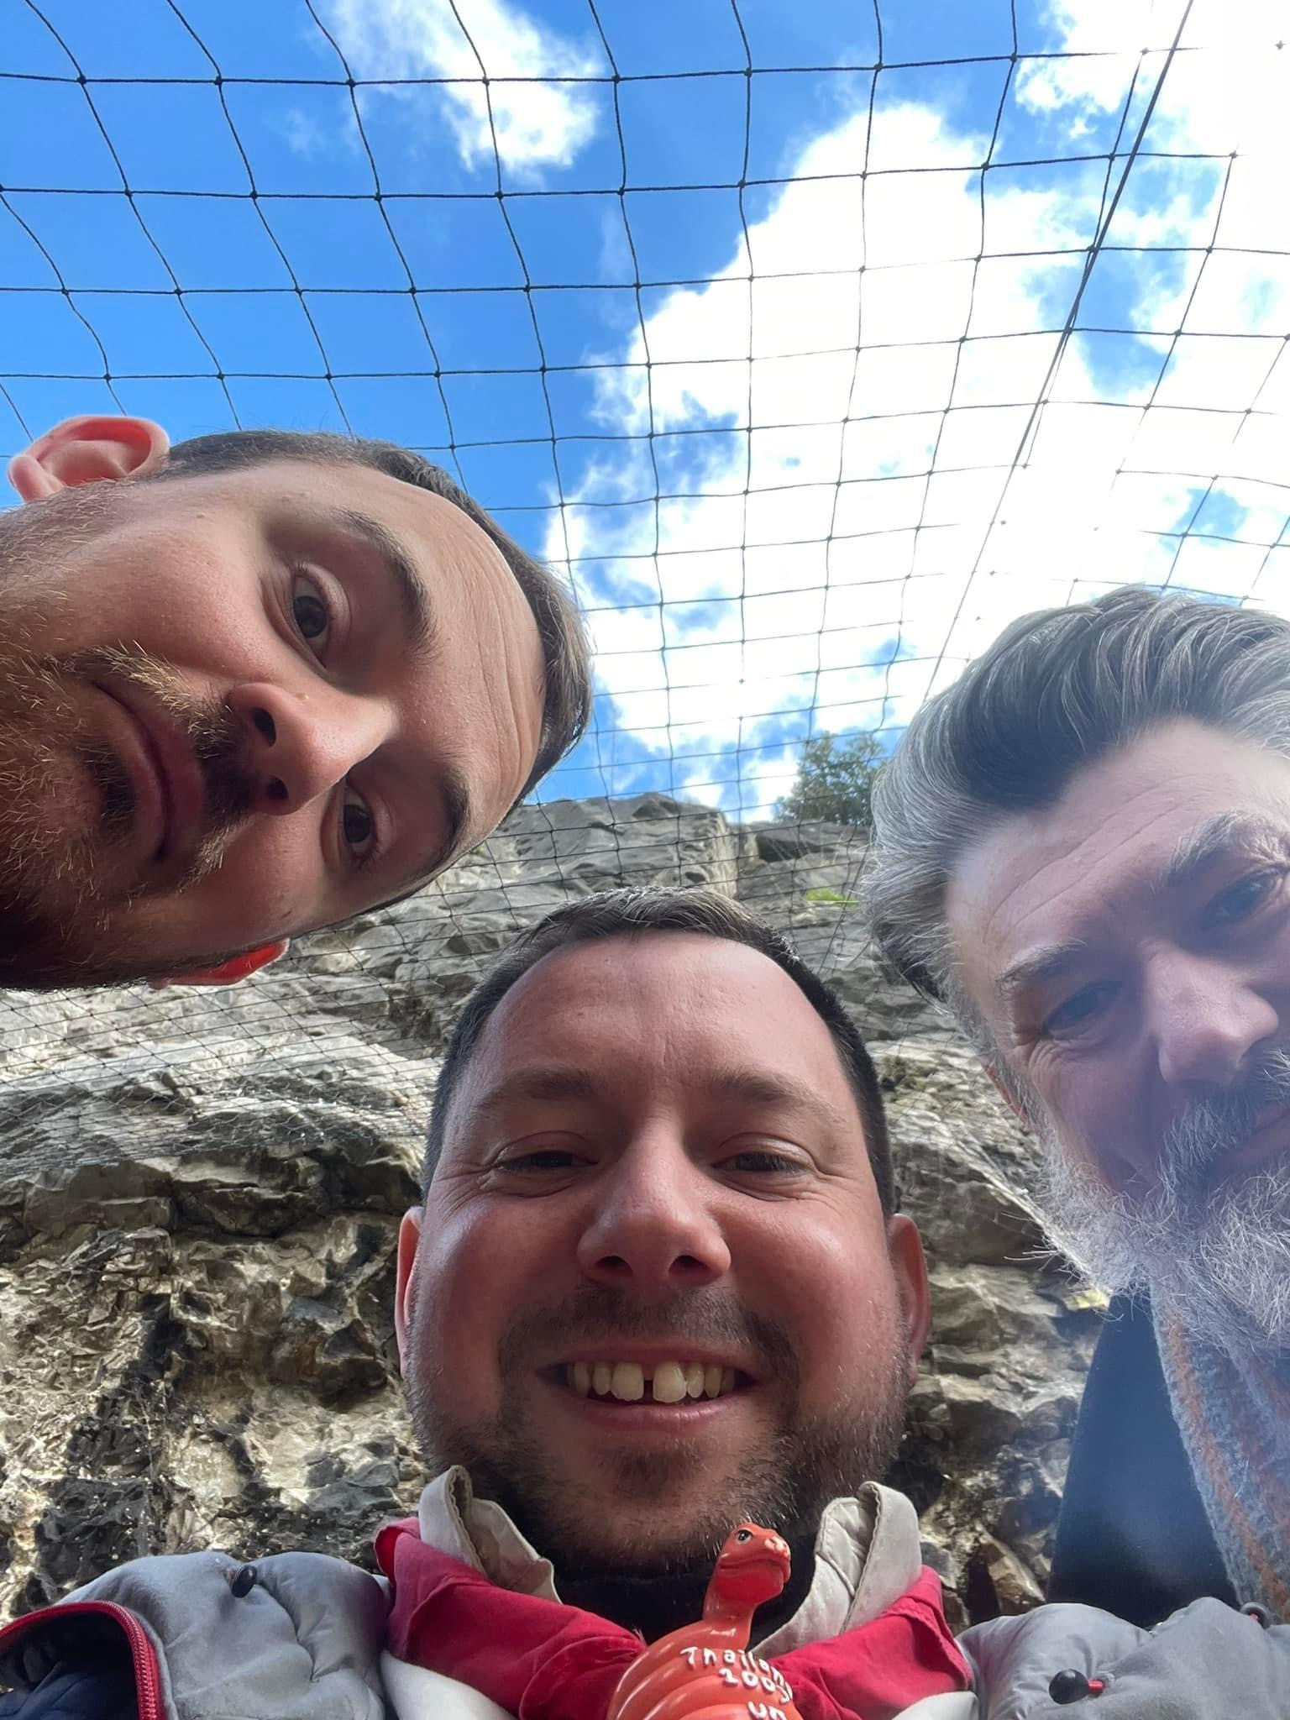
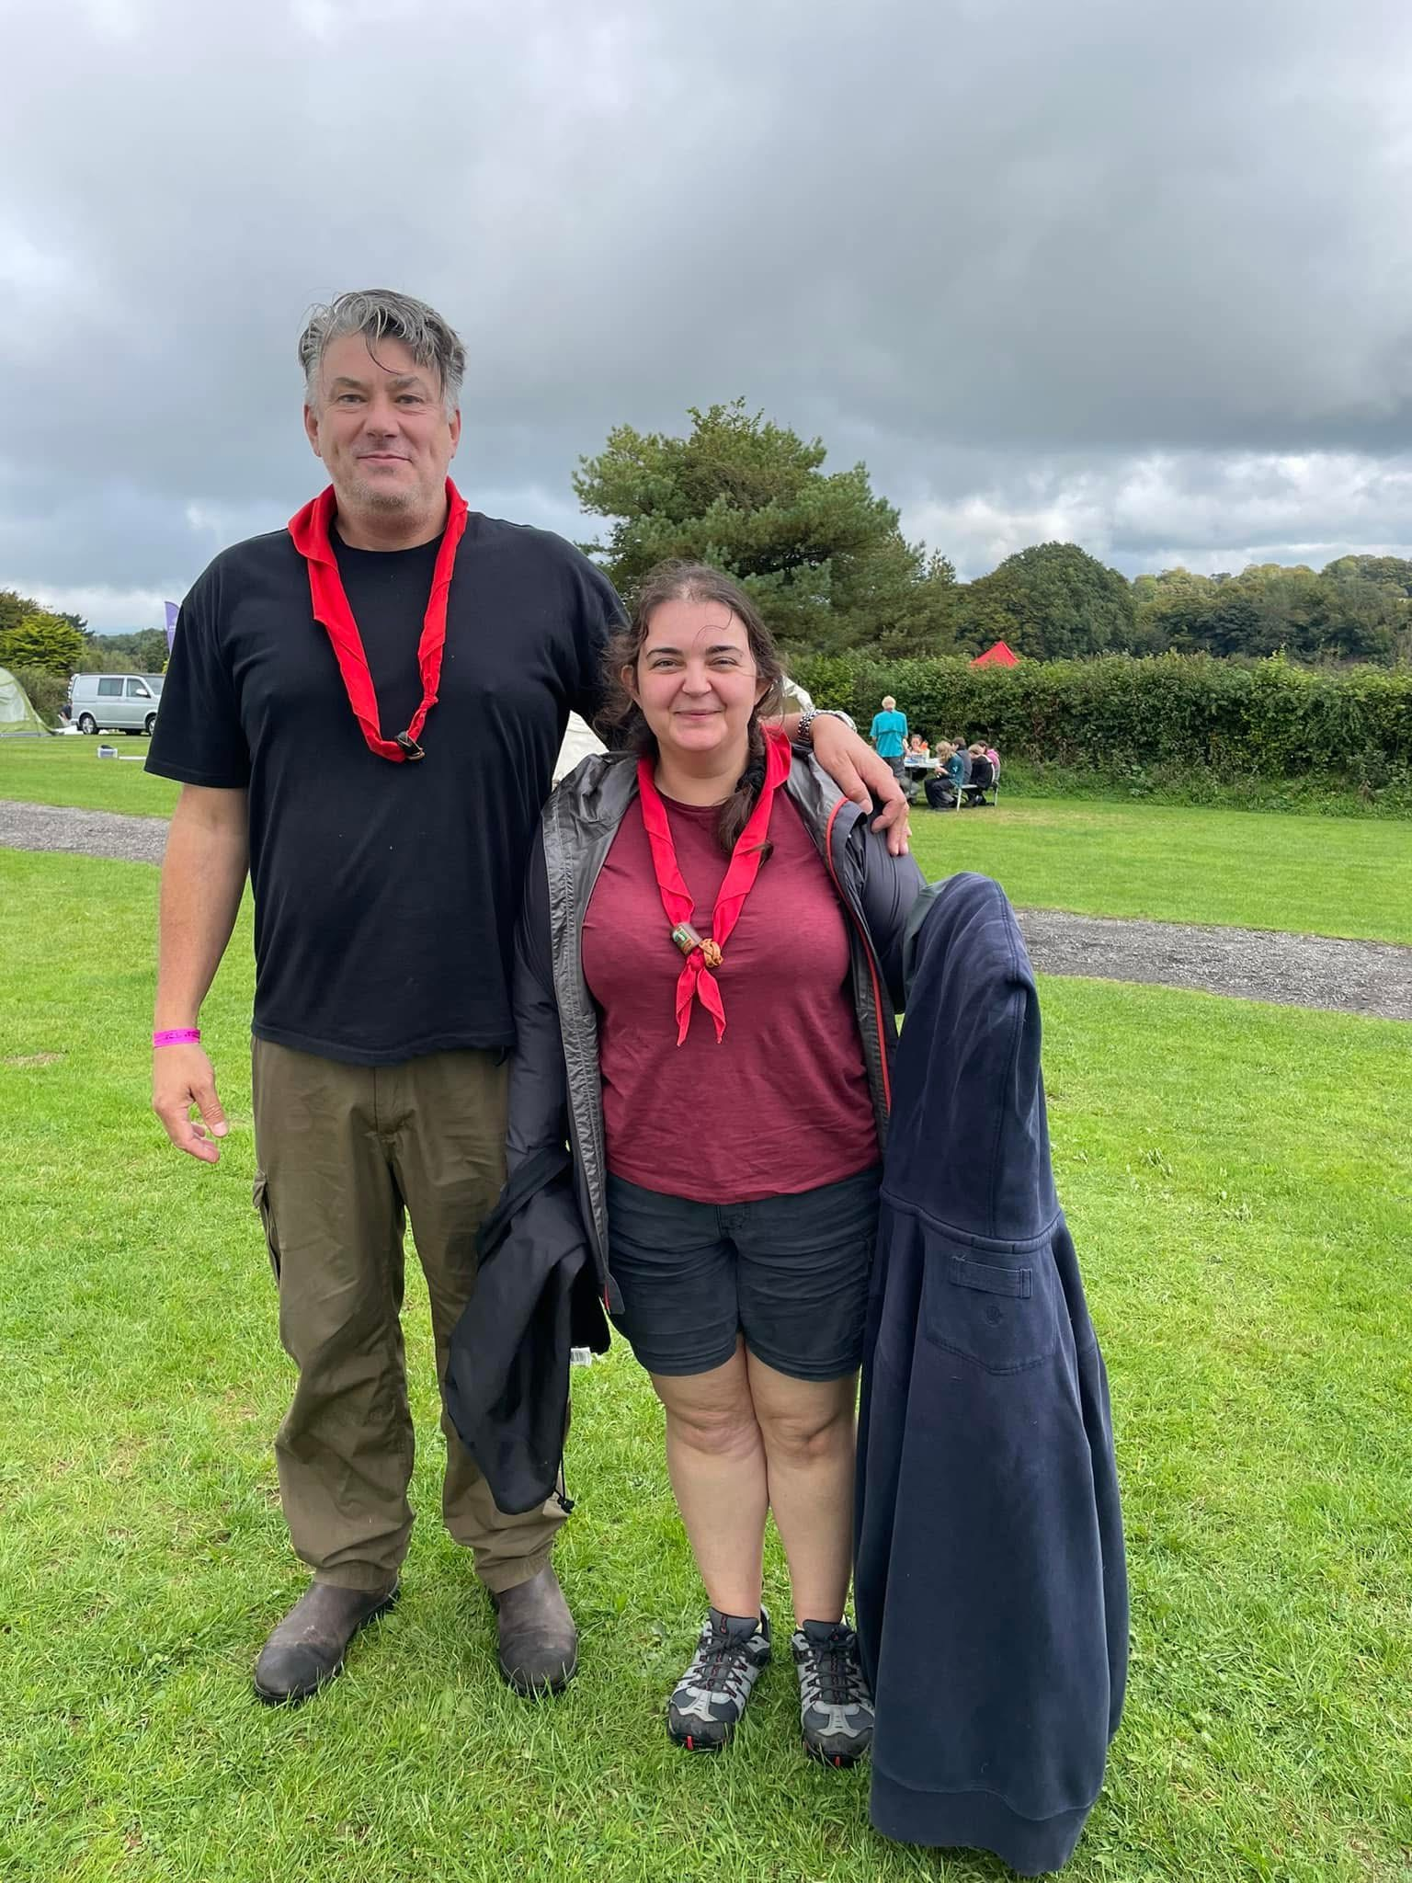
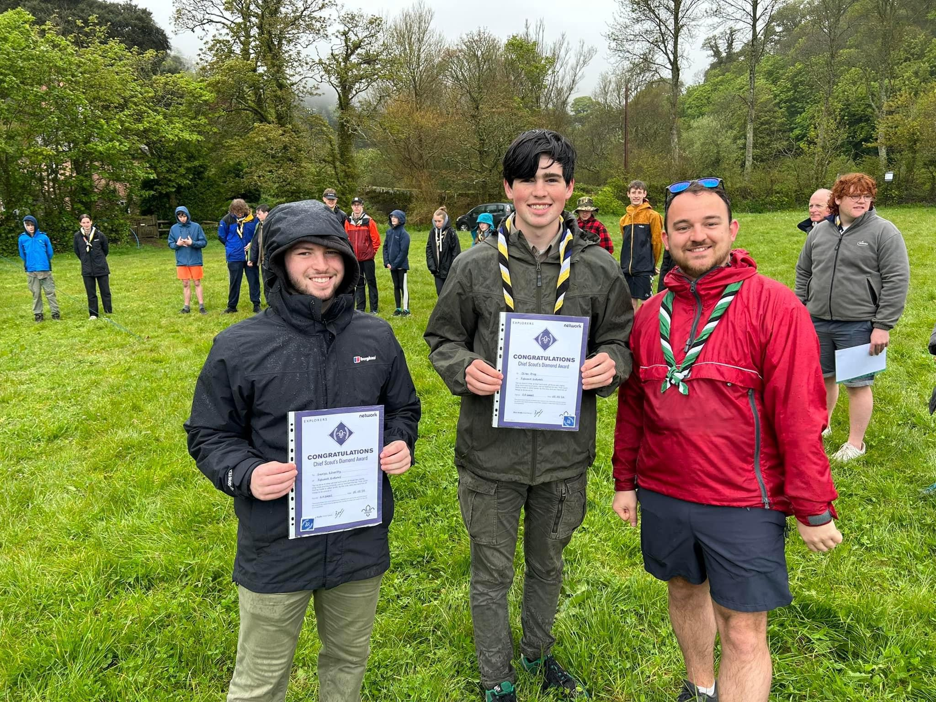
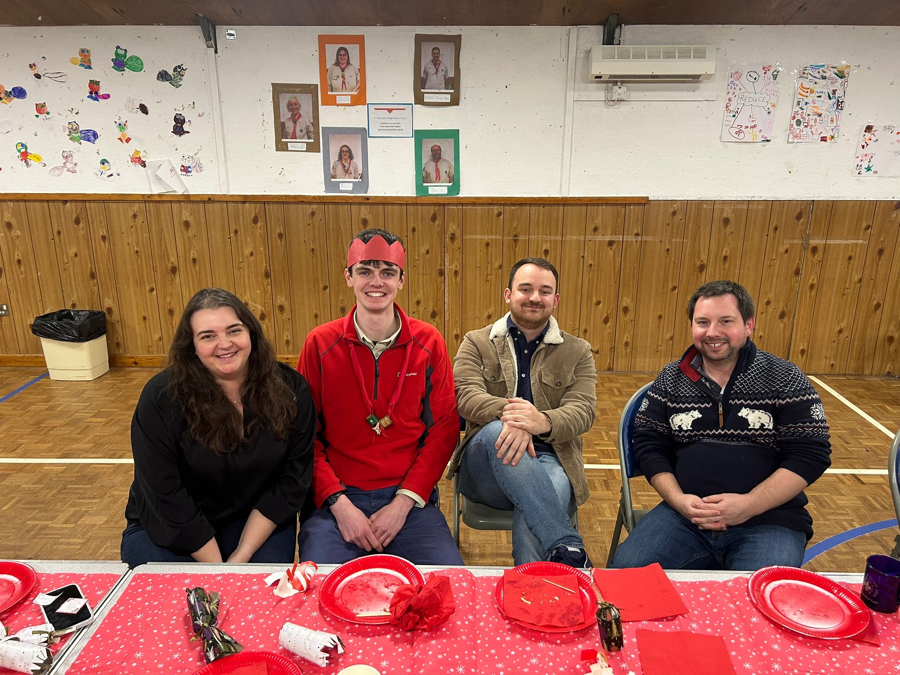
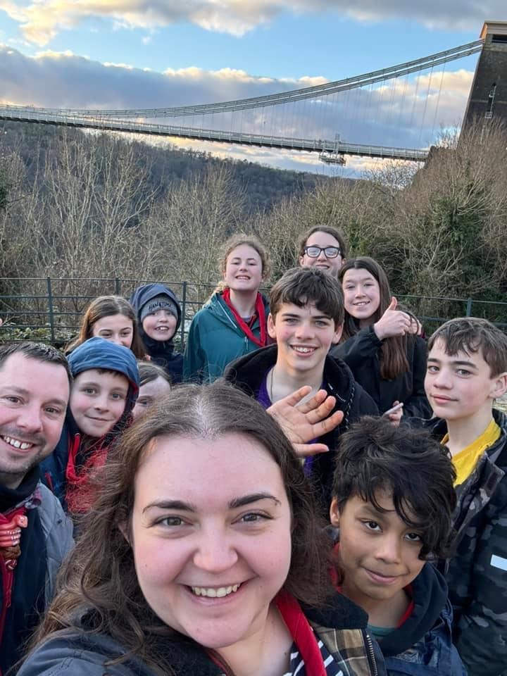
Your Scout Leaders:
The core age range is from 10½ to 14 years. A young person may join at 10 years and remain until 14½ years.
Scouts meet together as a Troop and work within a variety of small groups called ‘Patrols’ led by a Scout Patrol Leader. The Patrol Leaders work with the Leadership Team to help ensure the Patrol is ready and engaged in the planned activities each week. The Patrol system is one of the important ways that young people can take responsibility for themselves and others.
A volunteer leadership team made up of uniformed Leaders and other informal Assistants and helpers will guide the Troop.
Scouting has a reputation as an outdoor organisation based on strong traditions of camping and other outdoor pursuits.
Scouts work towards challenge awards, culminating in the Chief Scouts Gold Award, the Highest Award in Scouts.
Scouts also have the opportunity to gain a wide range of activity badges by working outside troop meetings and take a real commitment from the Scouts.
Most of the badges and awards in Scouts require independent work by the scouts themselves but can easily be earned by the extra-curricular activities Scouts already undertake.
We try and offer a number of nights away throughout the year. These are important to the life of the Troop, as they are the culmination of much of the work during the year.
At Highweek we attend the Hurdlestone Challenge, the County Woodlands Camp, and many other weekend camps of our own.
Highweek Scouts:
Meet every Wednesday, 19:00 to 21:00.
The Leaders at Highweek Scouts simply use their own names and are led by Graham who has been a Leader at Highweek for over 16 years.
Other Section Team Leaders at Scouts are Torsten, Alice, Rory, Patrick & Will. Alice E & Matthew are Young Leaders with the Troop.
Scout Contact Details:
Graham’s Email: graham.coates@teignbridgescouts.org

Slide 7

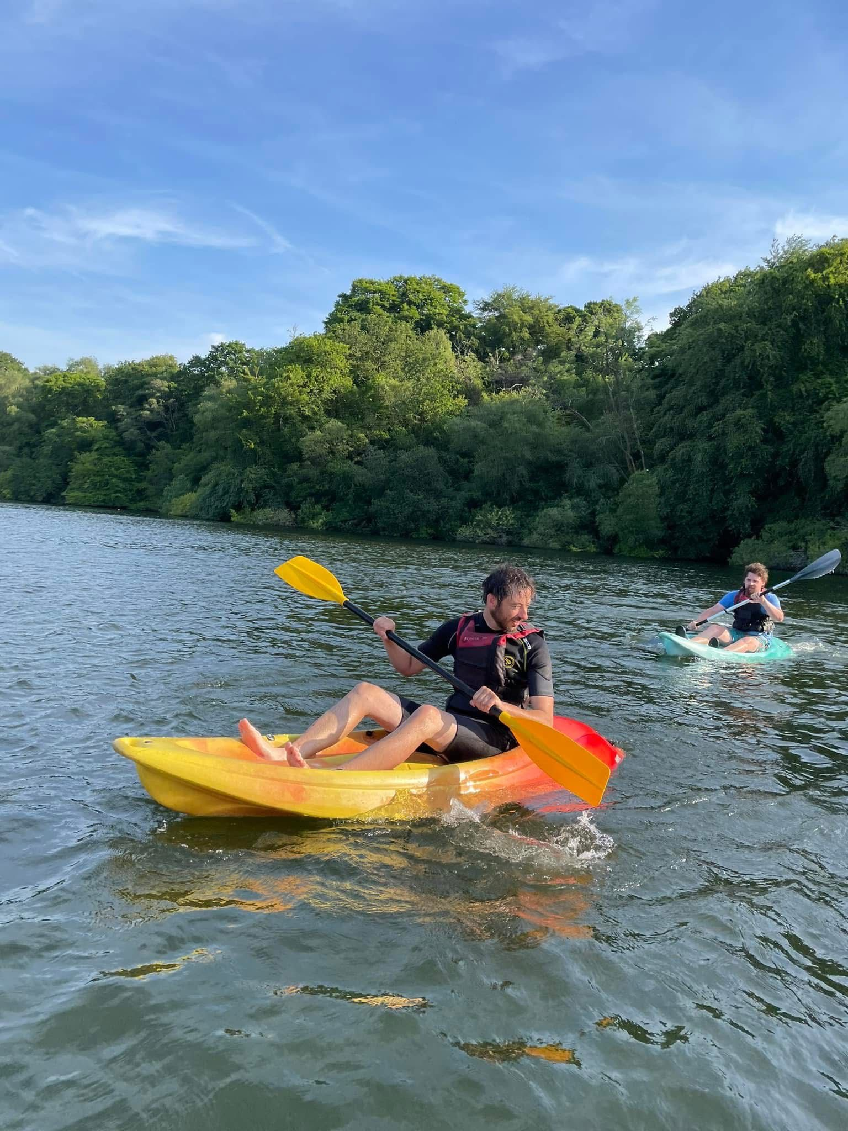
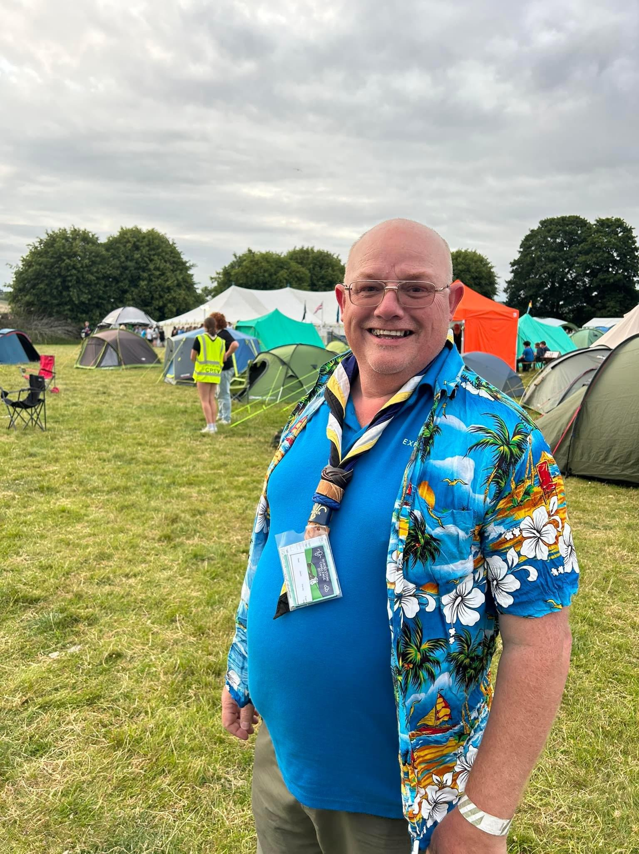
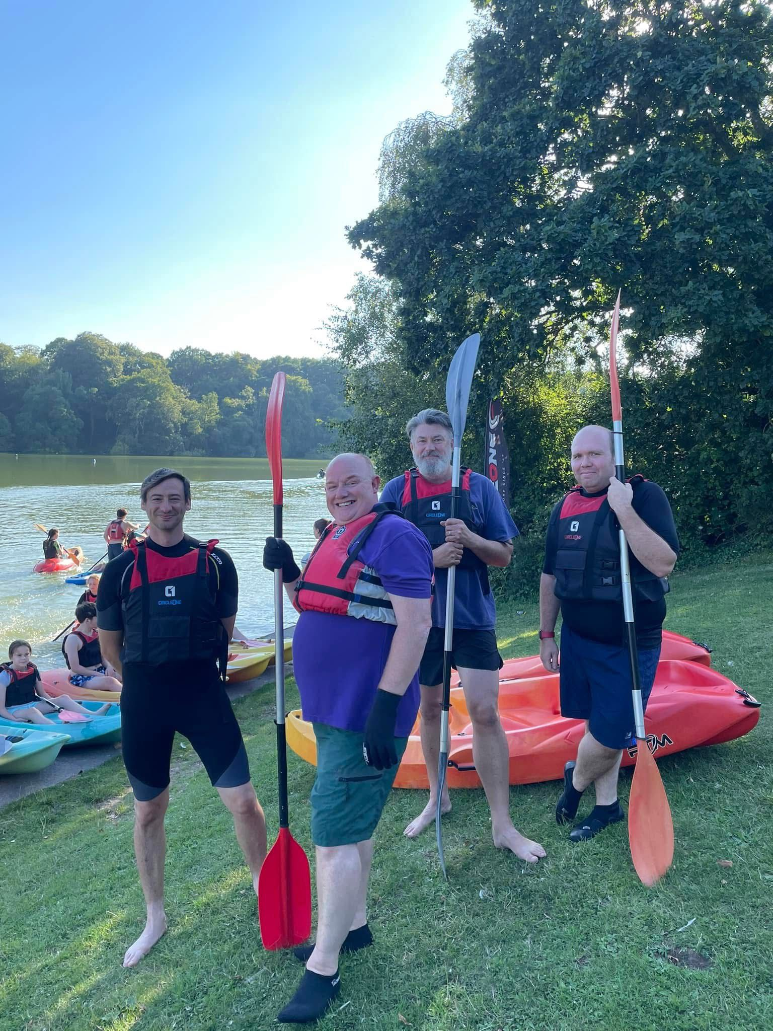
Your Explorer Leaders:
Explorers are a go-getting group of young people aged 14 to 18. Together, they make up the fifth section of the Scouts. Week in and week out, they gather in groups called Units to try new things, make new friends and conquer the small task of changing the world.
Discover the world
Being an Explorer is all about discovering the world on your own terms and making the most of what you have, wherever and whoever you are. Alongside your friends, you’ll master the skills that will make you feel stronger and happier in the long run, and try things you’d never get the chance to do at home or at school.
Whether you’re hiking to faraway lands or building a robot in your local scout hut, you’ll have the freedom to choose what you’d like to do and work together with adults to make it happen.
Start small, but think big
Explorers stand up for what they believe and make a difference on their own doorstops, confident in the knowledge that their daily actions add up.
Seek out the answers to big questions
Explorers seek out the answers to the big questions and to the smaller questions that don’t seem to matter but really should.
Most importantly, they say “Yes” more often than they say “No” whether they’re signing up for their first major hike across Europe, writing their first line of code or accepting the last of the toasted marshmallows.
Young Leader Scheme:
Explorers are also able to take part in the Young Leader scheme and volunteer as a young leader in another section. This not only provides a chance to learn new skills and build confidence, but there is also a recognised Young Leader award scheme to work towards. Many of Highweek’s Explorers have chosen to become Young Leaders with us.
Highweek Explorers:
Meet every Thursday, 19:00 to 21:00.
The Leaders at Highweek Explorers simply use their own names and are led by Anthony who has been a Leader at Highweek for over 5 years.
Other Section Team Leaders at Explorers are Jason & Andy. A number of Explorers are Young Leaders at the other Sections.
Explorer Contact Details:
Anthony’s Email: anthonyscagell@hotmail.co.uk

Slide 8
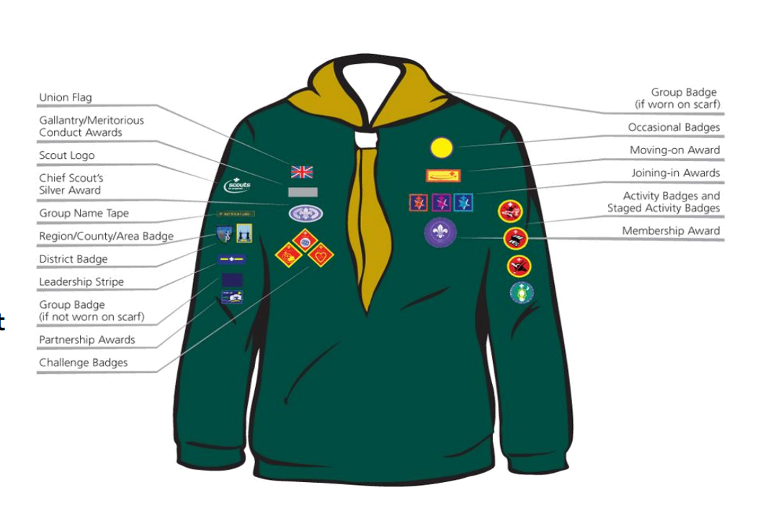
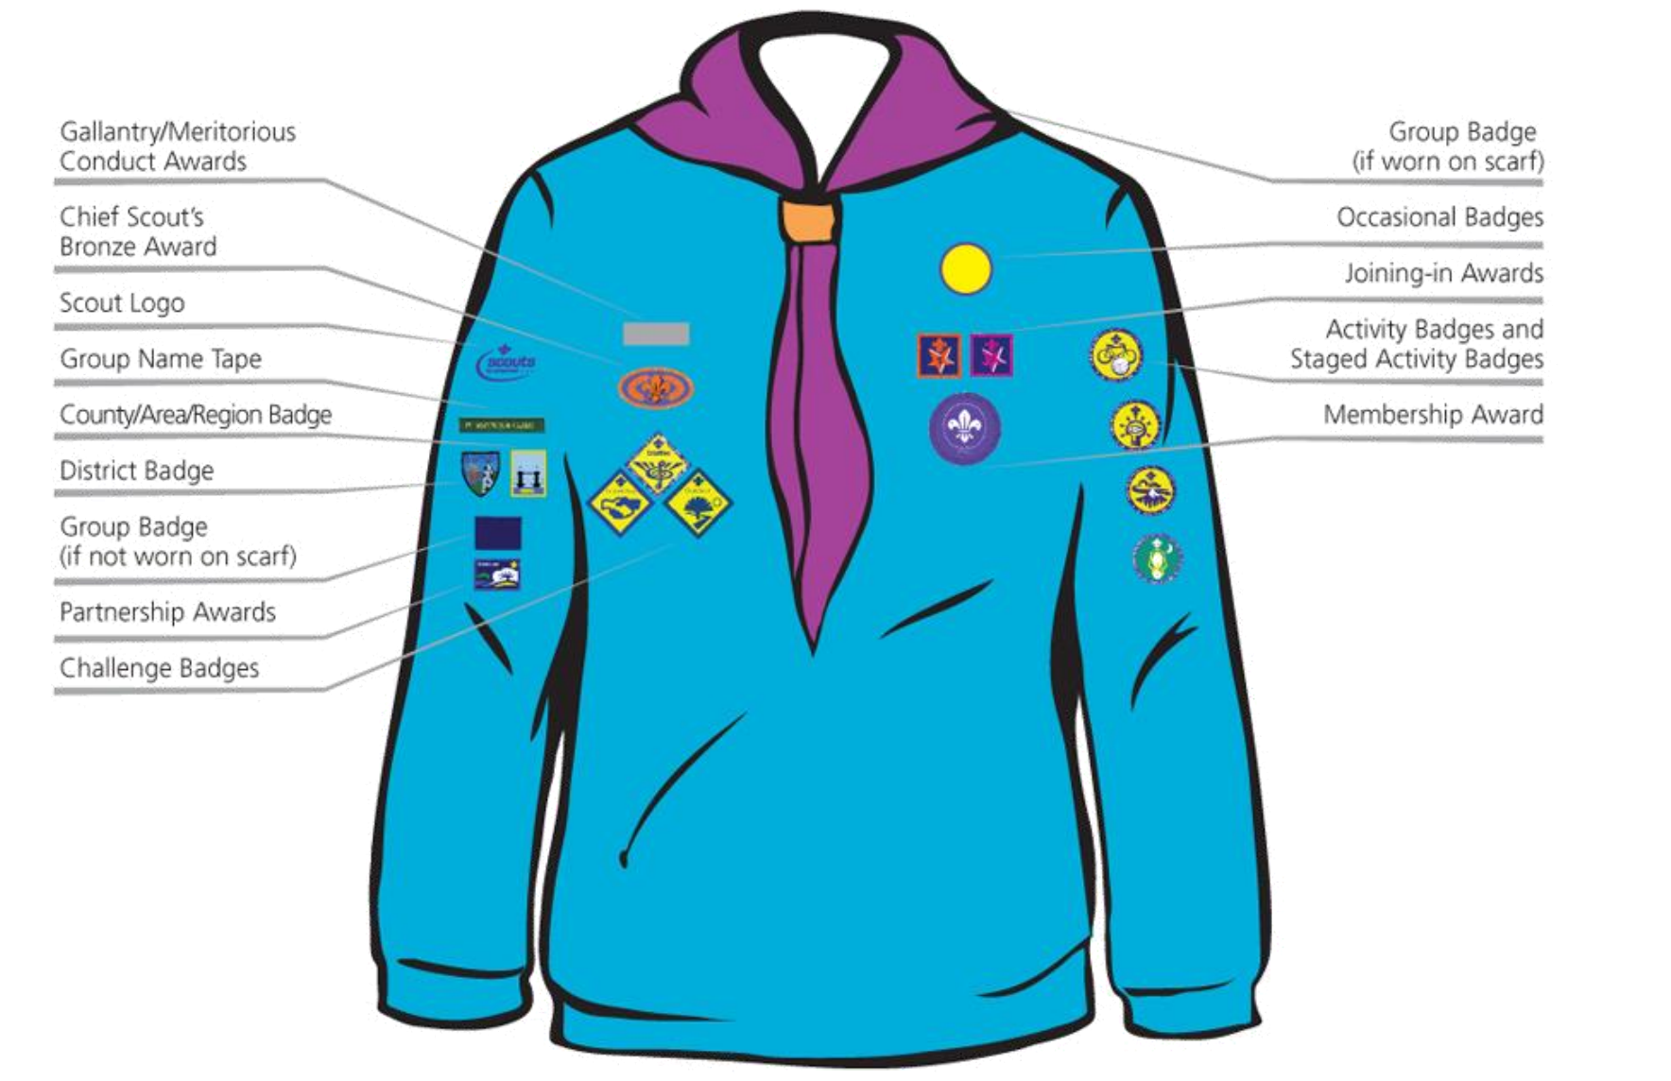
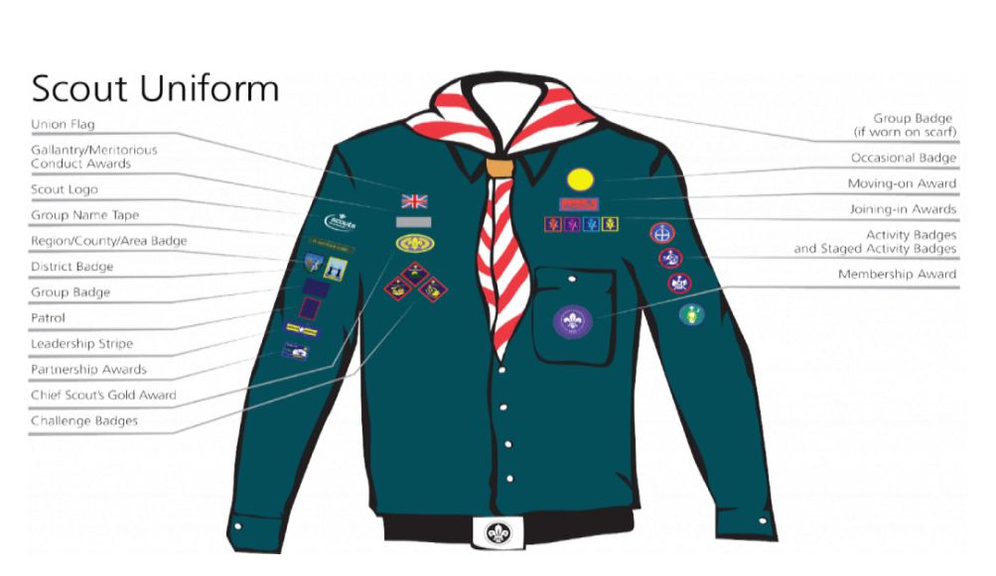
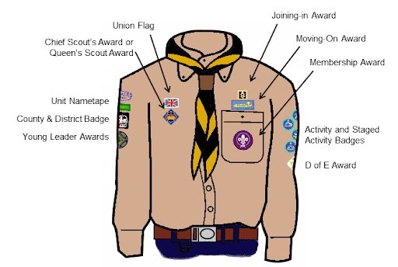
Badges & Uniform
Each section has its own uniform, although the activity trousers are common to all sections as is the Group Scarf with a woggle. Both a scarf and first woggle will be presented on investiture (making their promise) – our Scarf is a red one. Specific activities, such as camping or hiking, will have additional requirements. You will be notified of these in good time by your Section Team Leader.
We advise that Scouts have their names on every piece of their uniform!
Beavers
Beaver Scout uniform consists of the following items :
A Beaver Scout jumper
Scout activity trousers
A Beavers scout polo
Group scarf with a woggle
Cubs
Cub Scout uniform consists of the following items :
Green polo shirt
Scout activity trousers
Green sweatshirt
Group scarf with a woggle
Scouts
Scout uniform consists of the following items:
A Scout shirt
Scout activity trousers
Scout Belt
Group scarf with a woggle
Explorers
Explorer uniform consists of the following items:
An Explorer Scout shirt
Scout activity trousers
Scout Belt
District scarf with a woggle

Slide 9

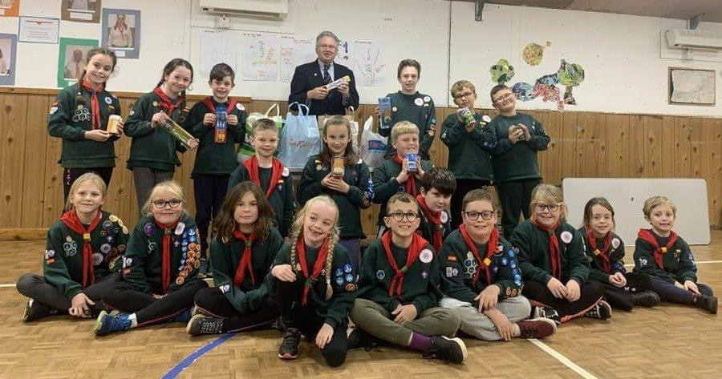
How Much Does Scouting Cost?
Scout Groups charge subscriptions to cover the cost of equipment and the resources to enable us to deliver good quality Scouting. Part of those subscriptions (subs) go towards the annual membership fee paid to headquarters for the day-to-day running of The Scout Association that includes some insurance for all members.
Each section at Highweek will also undertake activities that require an extra cost in order for us to do them; such as camping trips or Adventurous activities. Sections will subsidise these activities as much as possible but will inform you of any extra charges for these activities.
All of your leaders are unpaid volunteers, and we are always looking for more adults to join us!
At 1st Highweek Village Scout Group our subs are:
£12 per month, per child, due once your child has attended for 4 weeks. (First Month Free)
We ask that a standing order be set up at your bank so that Subs are transferred by the 5th of each month. Our bank details are:
Barclays Bank Plc, Newton Abbot
Sort Code: 20 60 88
Account Number: 00475556
Reference: Please use your child’s full name
Financial Help
We appreciate that funds can sometimes be tight. If you need help with the cost of a camp or if you want to spread the payments, then please have a quiet chat with one of the Leaders.
We are as flexible as possible and would rather know in advance than be chasing you later!
We are keen that everyone has the opportunity to attend at least one camp each year.
It is not our policy to exclude any young person from an activity because of cost, however we do not have a bursary fund.
Help your Subs go further…
Highweek Scout Group is able to recover income tax on any donation provided a declaration has been made to cover the tax reclaim.
Donations may now be of any value. The only criteria is that the individual making the donation has to pay income tax or capital gains tax of at least the amount to be recovered by the Group.
If you complete a declaration, up to 25p in each £1 can be claimed back by the Group from the ‘Tax Man’. This will really help the Group’s finances and cut down the pressure on the essential fundraising!
Please speak to a Leader if you need a Gift Aid declaration form.

Slide 10

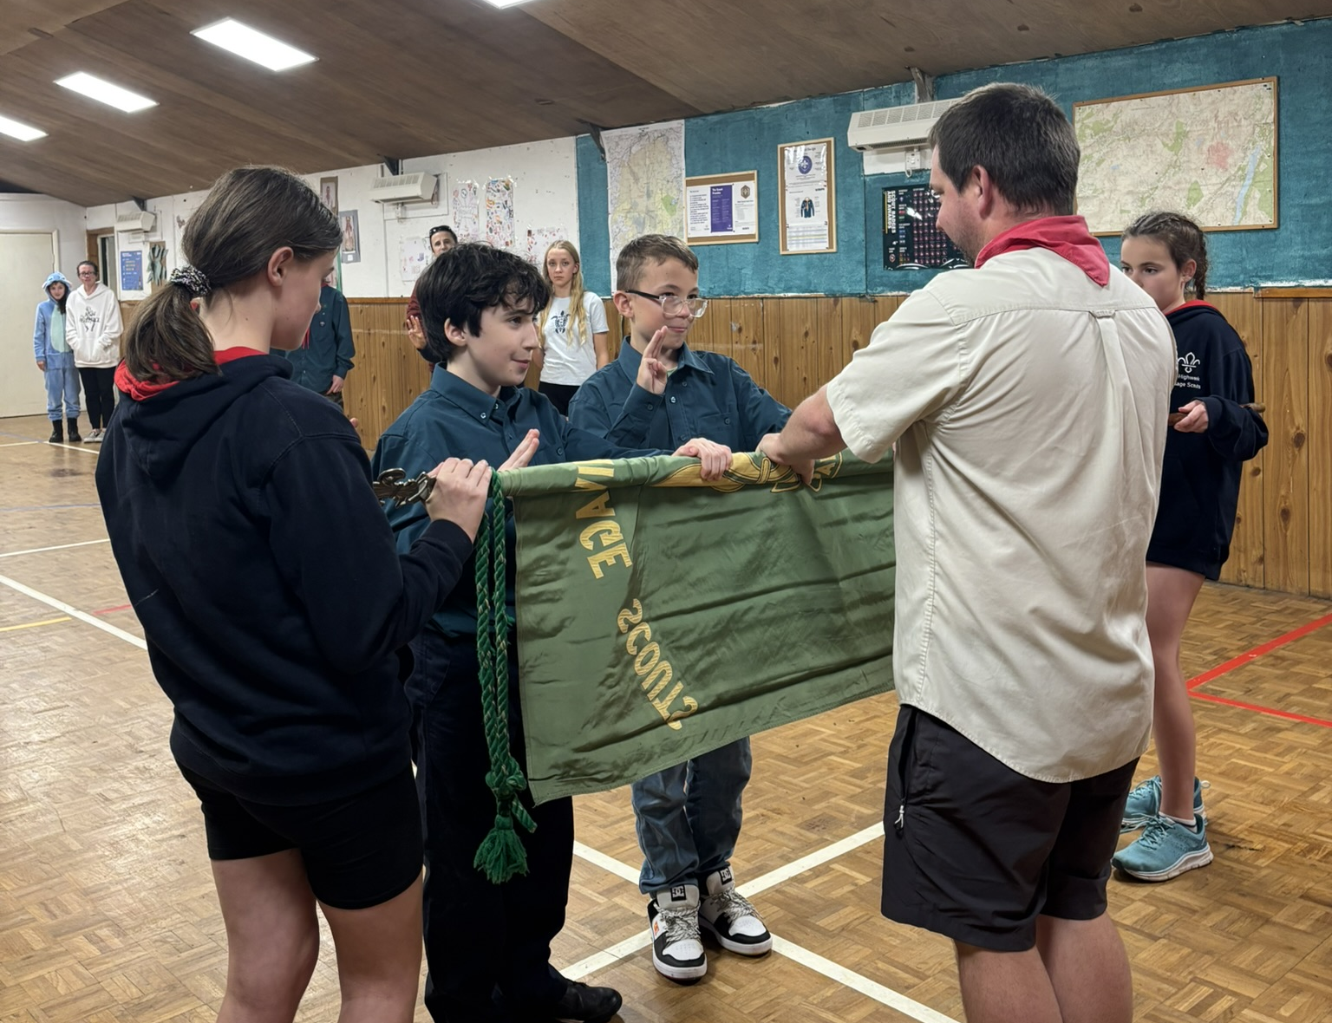
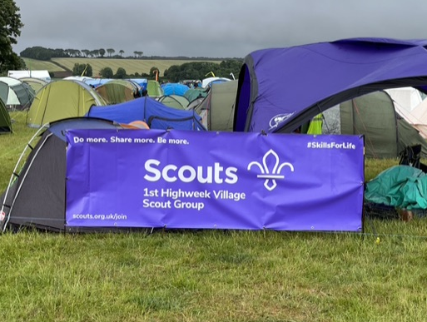
Membership Details
The Scout Association in the United Kingdom is a membership organisation. To enable it to operate - and to communicate with its Members - it is necessary to maintain accurate records.
This will include details of name; address; date of birth; contact telephone numbers along with details of your young person’s progress through Scouting (e.g. badges gained).
Information held in our Scout Group may be shared from time to time within Scouting including the National Headquarters of The Scout Association.
Legislation came into force in March 2000 that covers the protection and processing of personal data. Adults and young people have the same rights under the Data Protection Act 1998. The Act covers paper-based (as well as computer-based) information. Certain information is classed by the law as 'Sensitive Personal Data’.
In a Scouting context this may include information about your young person:
Health (to ensure that we are prepared for medical emergencies it is important that we hold relevant information).
Additional Needs (to ensure a safe integration and participation in activities, details of any additional needs to be known).
Religious or similar beliefs (only used for our annual census to the Scout Association for them to understand the take up of Scouting).
Racial or ethnic origin (only used for our annual census to the Scout Association for them to understand the take up of Scouting).
Images (we may use images to promote scouting).
Images may be used in our recruitment or in other printed publications that we produce, as well as on our website. First names only will be published. Our scout group may be visited by the media to take photographs or film of a visiting dignitary or other high profile event. Your young person may appear in these images, which may appear in local or national newspapers or on televised news programmes.
Email addresses (will be used and shared with other members of the group to help arrange scouting activities).
To hold this 'Sensitive Personal Data' we will need your consent. This can be given by completing the Personal Information Form when joining 1st Highweek Village.
All of the information will be used only in connection with your membership of the Scout Movement in the United Kingdom. This will include membership management and communications. None of the information provided will be passed to any third parties outside the Scout Movement.

Slide 11
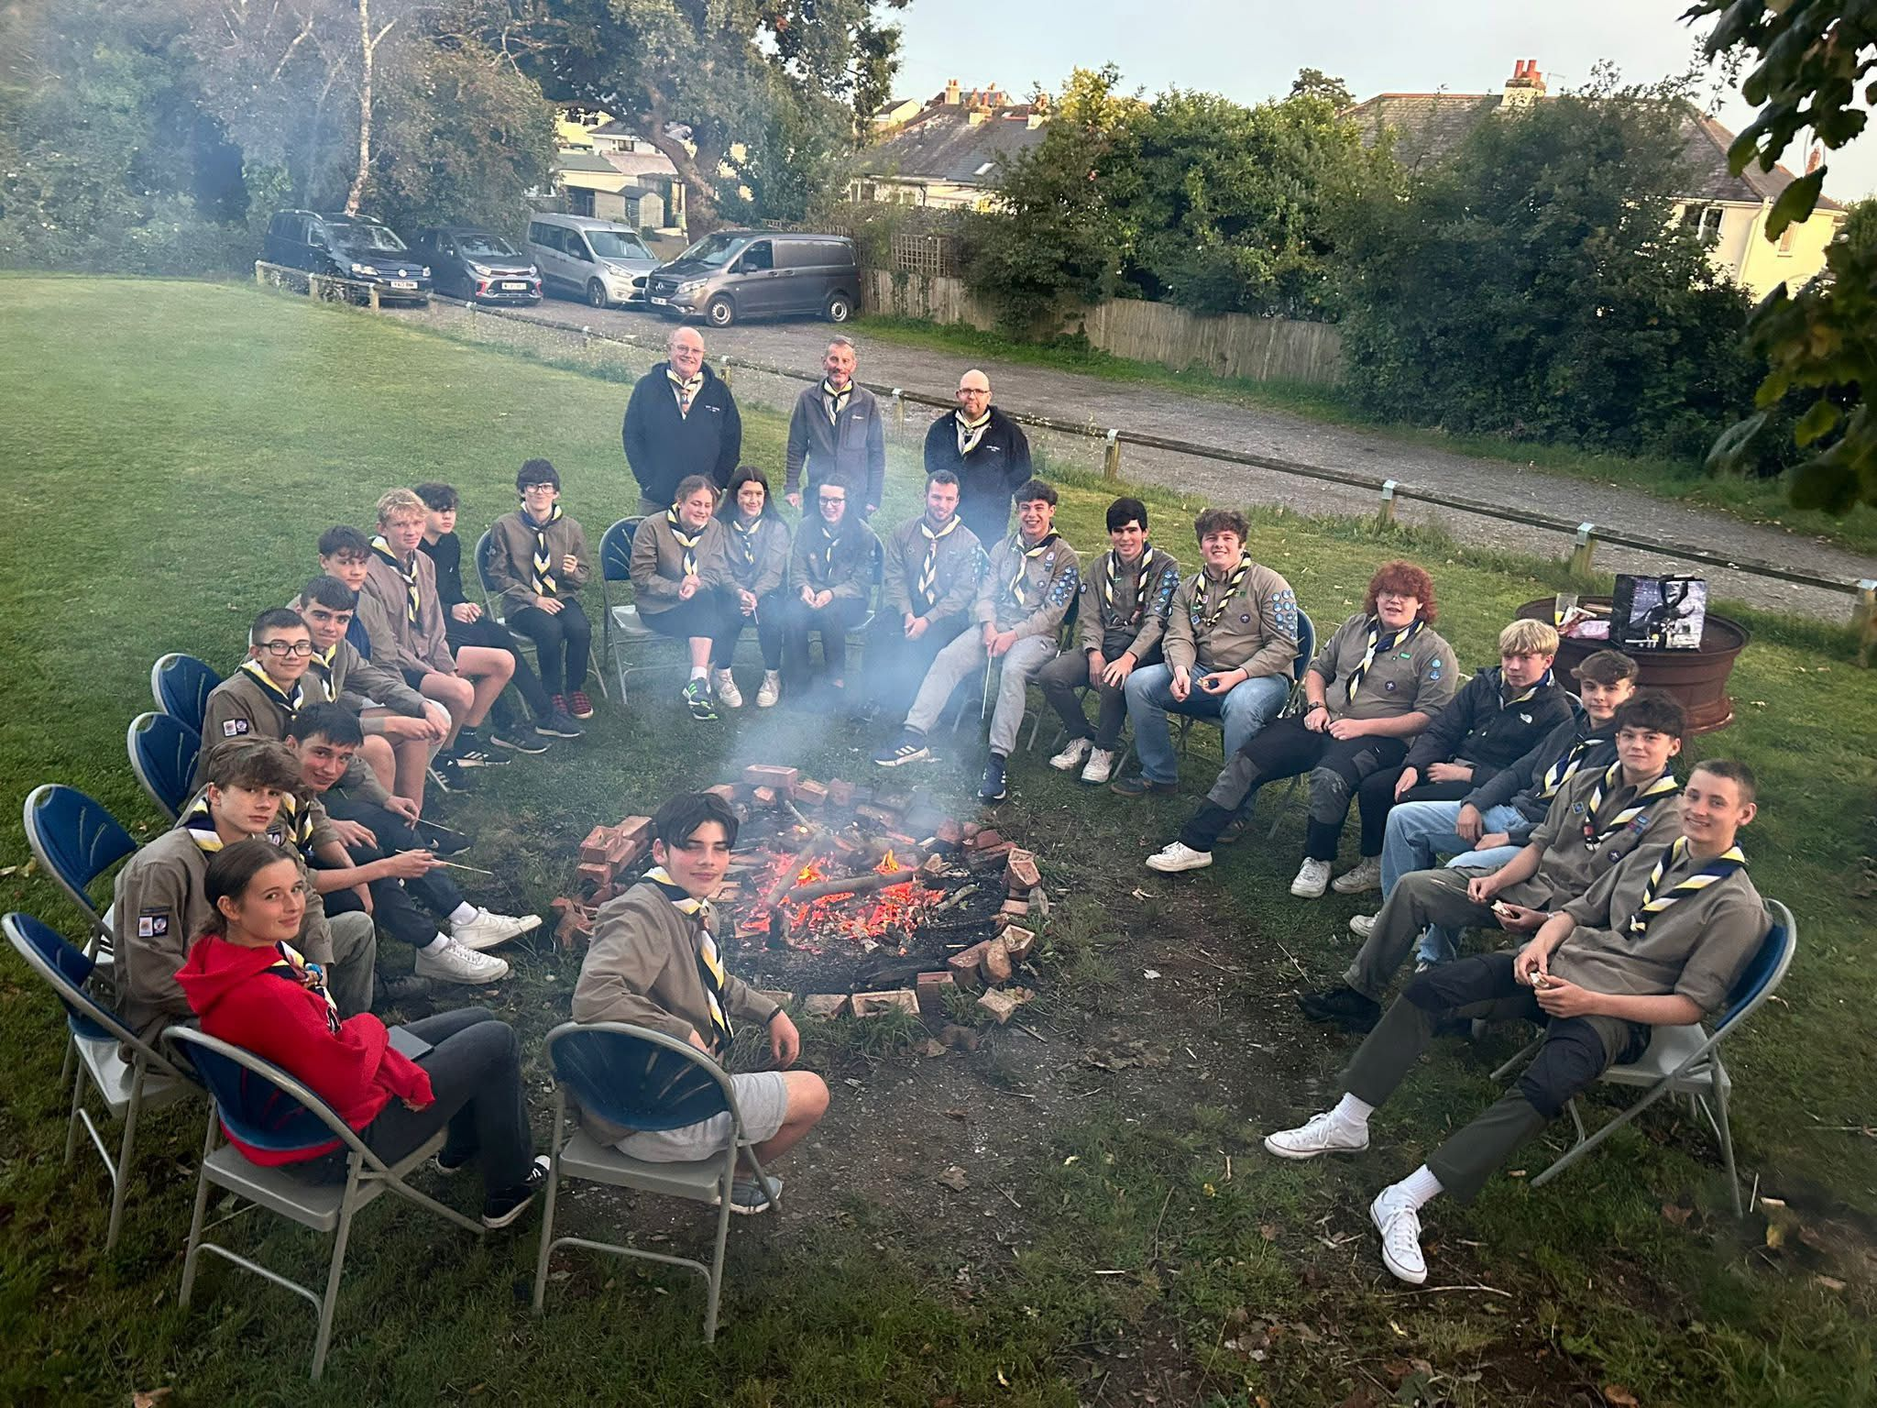
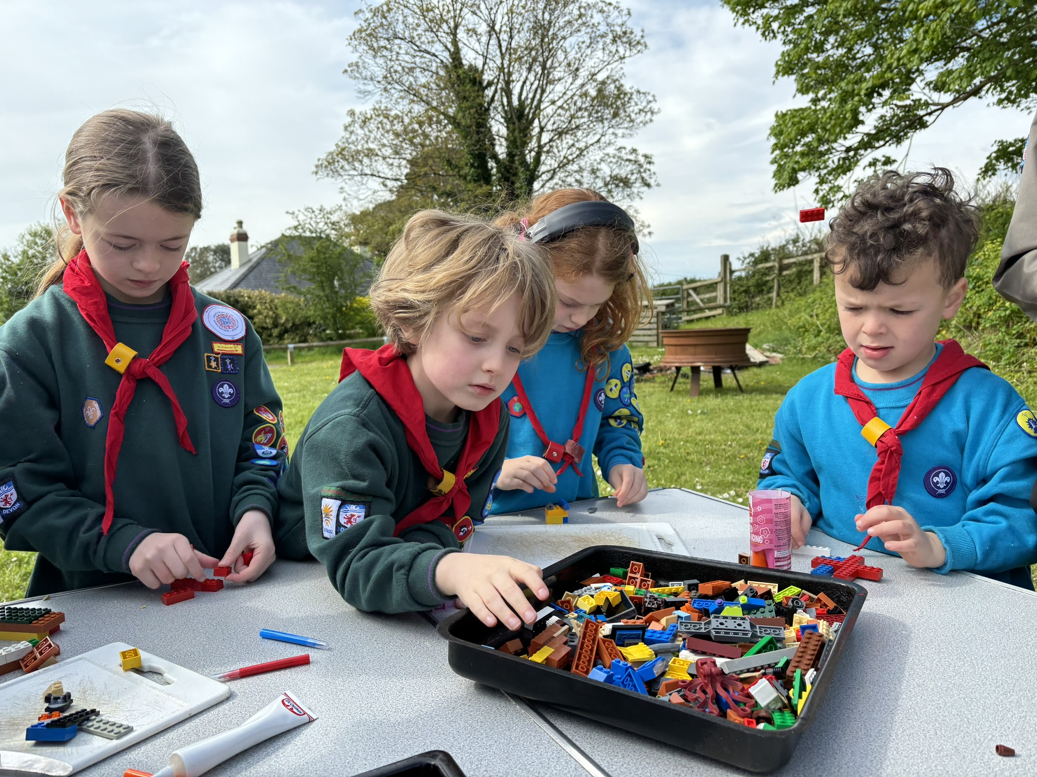
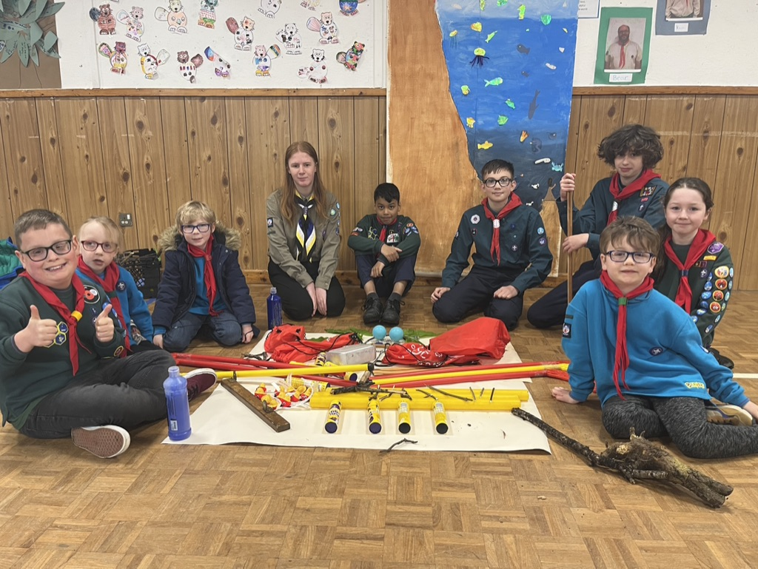

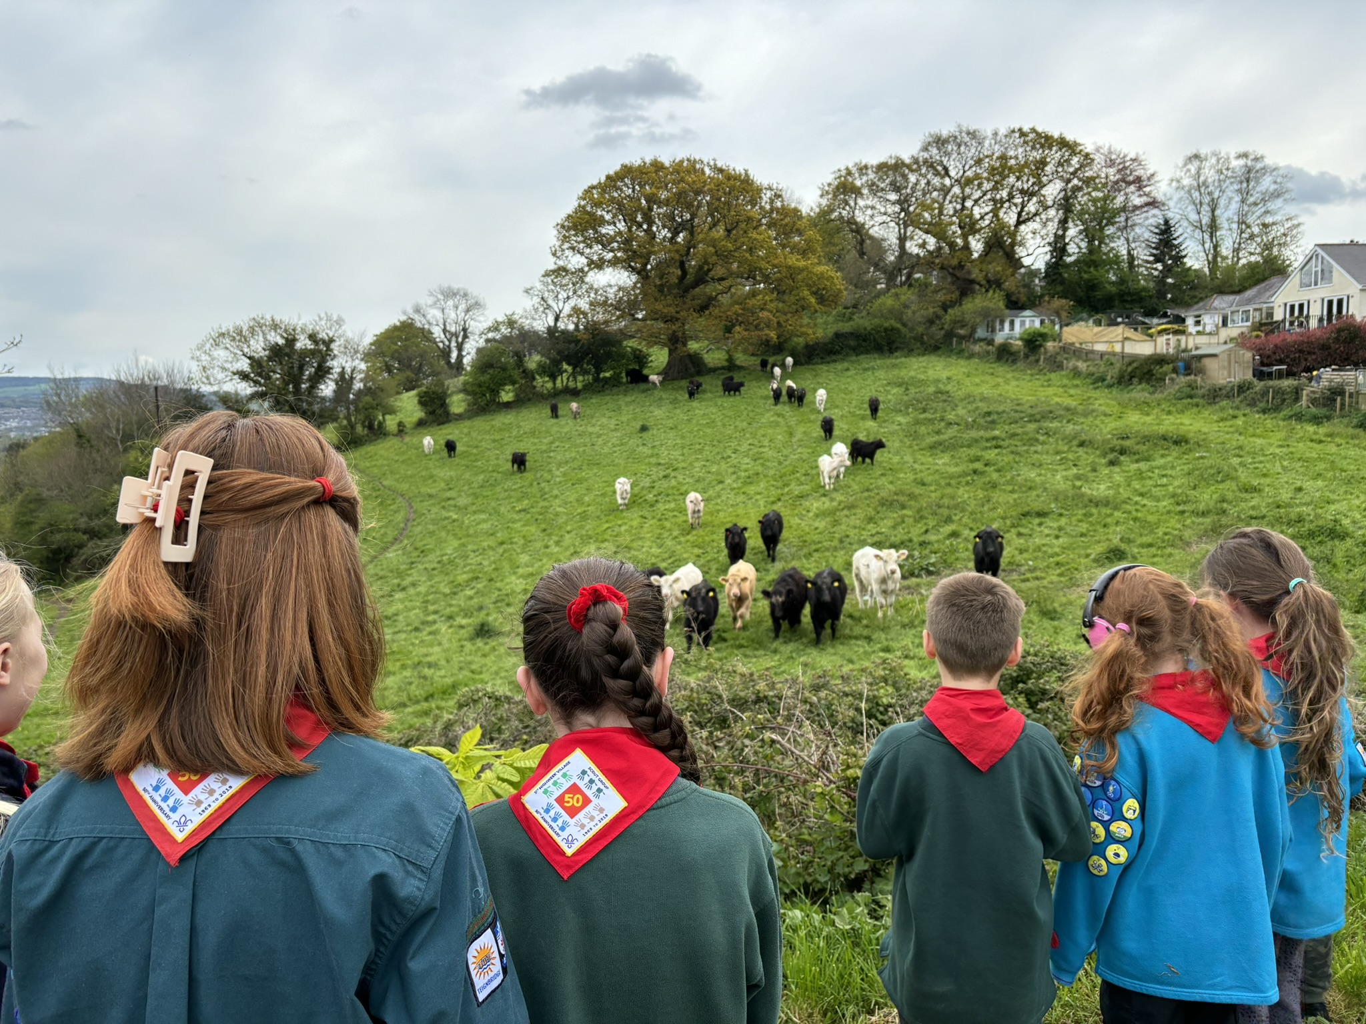
Change of Details
The information which you give when you join will be used by the Section Team Leaders. The details will be used by the Treasurer (for subscription and Gift Aid purposes only).
You will be asked to check these details at least every year and prior to residential events to ensure our records are kept up to date. This is also required by data protection regulations. You can update your or your young person’s details at any time.
Data
We are a small Charity but still subject to compliance with the Data Protection Regulations. In signing the member details form, you will be agreeing to the Scout Group during and beyond your child’s involvement with the organisation:
Retaining personal data to facilitate any present or potential future involvement with Scouting;
Retaining personal data regarding religion, special needs/disabilities, ethnicity, medical information and/or commission of offences or alleged offences; and
Allowing access to personal data to appropriate individuals within the hierarchy of Scouting.
The Yellow Card
The Scout Association's child protection policy is known as the 'Young People First' policy. It's often referred to as the ‘yellow card’ policy because of the pocket sized yellow reminder card all adults are asked to keep and carry with them.
The 'Young People First' policy is held up as an example of best practice and praised by the child protection agencies. The Scout Association also enjoys the confidence and trust of thousands of parents who each week place their children in our care.
If you would like a copy of the Yellow Card or more Information on the policies of the Scout Association please speak to your Section Team leader who will be able to point you in the right direction.

Slide 12

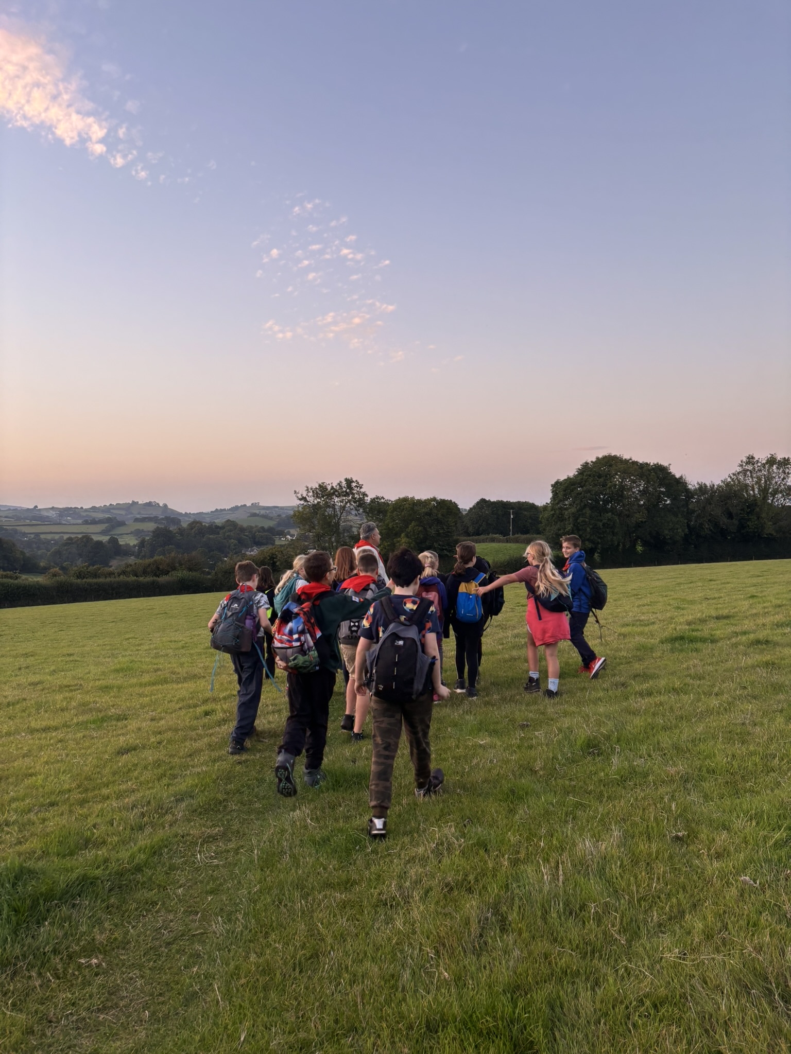
Communicating with your Leaders
The Scout Group generates lots of information and instructions for Members and their parents / guardians. We are conscious that alongside the other organised activities your child may take part in, plus School communications, that ours may get lost within the general chaos of life! That’s ok!
If you need to reach out to your Section Team Leader and seek clarification on anything, please do so. You will find that the leaders of each Section have their own preferred mechanisms, but these tend to include:
● Online Scout Manager (OSM) – this is a website that we use to keep all our scouting records, we use it to help get parents to sign up for events and activities and also take payment
● Some sections may use WhatsApp for urgent information prior to or during an activity
● Emails giving programme updates and reminders
● Each section has a Private & Closed Facebook Group to share photos and videos of activities as well as for general updates, events and discussions.
We make every effort to rationalise the information but it is important that you read and respond promptly to messages to ensure that your young person does not miss out.
What is OSM?
Online Scout Manager (OSM) is website created and run by former Scout Leaders designed to aid record management and to reduce some of the ‘admin’ of being a Scout Leader.
Each section will use OSM to record:
The Programme
Badge records of each child
Attendance
Personal Details
Event attendance and details
Risk Assessments
There is a Parent Portal Function in OSM which enables Parents to update their child’s personal details, sign up for events and also check badge progress. Please let your Section Team Leader know if you need access to the Parent Portal.
Concerns
It goes without saying that if you have any questions or concerns; please raise them with the appropriate Section Team Leader or with our Group Lead Volunteer, Andrew.
Handy Tip: If you need to talk to a leader there tends to be more time at the end of a meeting than beforehand. Often an email or a text message saying that you would like a chat helps too.

